Slide 1
The Volga in poems and songs
Районная краеведческая конференция младших школьников
«Мое первое открытие
Презентация на английском языке Салушкина Артема, ученика 4 класса МОУ «СОШ с. Тепловка Новобурасского района Саратовской области» руководитель Кожохина М.А., учитель английского языка МОУ «СОШ с. Тепловка Новобурасского района Саратовской области»

Slide 2
My name is Artyom Salushkin. I live in Tyoplovka, Novye Burasy District, Saratov Region. I study at Tyoplovka Secondary School in the 4th Form.
I like to read poems. I’d like to tell you about poems to the Volga, the great Russian river and the main river of our Region.

Slide 3
Konstantin Balmont, a great Russian poet said: “There is no Egypt without the Nile, there is no India without the Gang, there is Russia, one of the most beautiful countries, because it has the Volga.”
Нет Египта без Нила, нет Индии без Ганга, есть в ряду величайших прекраснейших стран Россия, потому что у нее есть Волга. Бальмонт

Slide 4
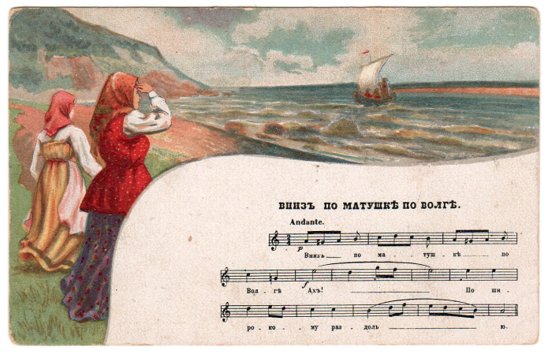
There are a lot of folklore songs about the Volga. The most famous are "Ах ты, Волга ли, Волга-матушка", "Волга, реченька глубока", "Вниз по матушке по Волге", "Волга, моя матушка“. We know different old legends, true stories and tales about the Volga. It also attracted some great Russian poets of last centuries.

Slide 5
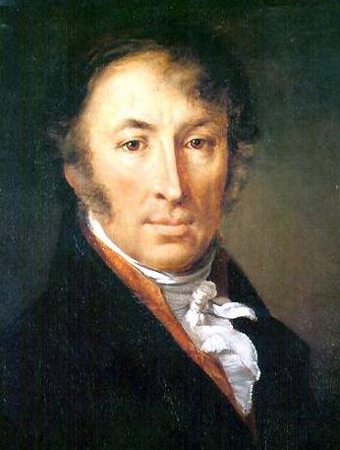
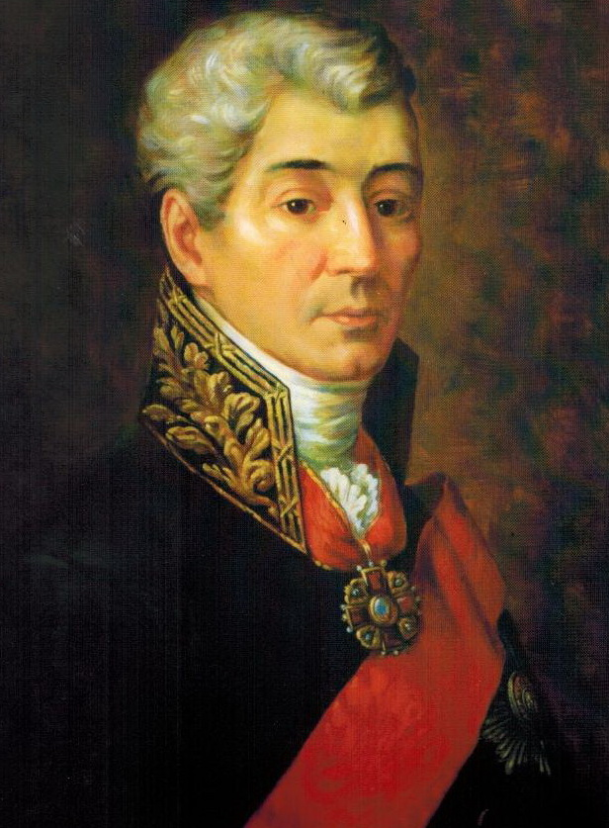
A lot of poets wrote about the great Russian river, the Volga.
The first poets were N.M. Karamzin who wrote the poem “The Volga” (1793) and I.I. Dmitriev who wrote the poem “To the Volga” (1794)

Slide 6
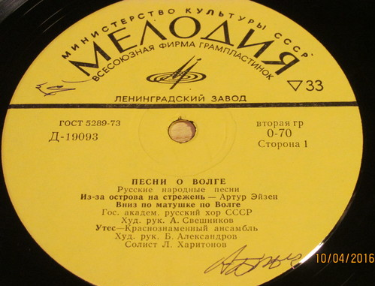
Some poets, A.A. Shahovskoi, N.N. Mansyrev, A.V. Shiryavtsev have poems like folklore.
Some poems became folklore songs: "Меж крутых бережков..." (M.I. Ozhegov), "Из-за острова на стрежень..." (D.N. Sadovnikov), "Далеко, далеко степь за Волгу ушла..." (U.P. Rosengeim), "Дубинушка" (L.N. Trofelev), "Утес Стеньки Разина" (A.A. Navrotski)

Slide 7
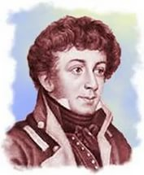
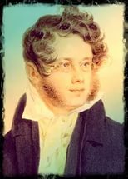
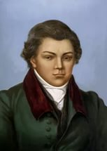
In poems by K.N. Batyushkov, P.A. Vyazemski, N.M. Yazykov the Volga is the symbol of Russia, the Motherland.

Slide 8
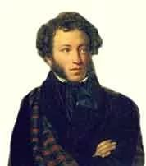
A.S. Pushkin visited the Volga in 1833. He wrote “Songs about Stephan Rasin”

Slide 9
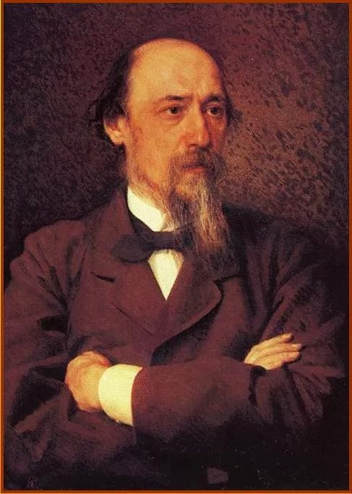
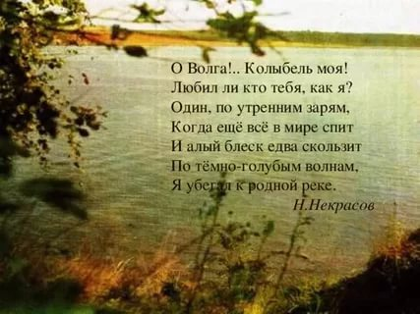
In 19th century the poets wrote about boatmen and their work on the Volga. The poems are not romantic, they are about difficult real life. The most famous poet is N.A. Nekrasov. His poem about the Volga is “On the Volga”.

Slide 10
There is a music English interpretation of Russian song “Эй, ухнем!”. It is called “The Song of the Volgaboatmen”. A famous American bandmaster Glenn Miller made it in 1941and it became a hit.

Slide 11
SONG OF THE VOLGA BOATMEN
Yo, heave ho! Yo, heave ho! Once more, once again, still once more Yo, heave ho! Yo, heave ho! Once more, once again, still once more
Now we fell the stout birch tree, Now we pull hard: one, two, three. Ay-da, da, ay-da! Ay-da, da, ay-da! Now we pull hard: one, two, three.
As the barges float along, To the sun we sing our song. Ay-da, da, ay-da! Ay-da, da, ay-da! To the sun we sing our song.
Hey, hey, let's heave a-long the way to the sun we sing our song Yo, heave ho! Yo, heave ho! Once more, once again, still once more
Volga, Volga our pride, Mighty stream so deep and wide. Ay-da, da, ay-da! Ay-da, da, ay-da! Volga, Volga you're our pride.
Yo, heave ho! Yo, heave ho! Once more, once again, still once more Yo, heave ho! Yo, heave ho!
ЭЙ, УХНЕМ (слова народные)
Эй, ухнем! Эй, ухнем! Ещё разик, ещё да раз! Эй, ухнем! Эй, ухнем! Ещё разик, ещё да раз!
Разовьём мы берёзу, Разовьём мы кудряву! Ай-да, да ай-да, Aй-да, да ай-да, Разовьём мы кудряву.
Мы по бережку идём, Песню солнышку поём. Ай-да, да ай-да, Aй-да, да ай-да, Песню солнышку поём.
Эй, эй, тяни канат сильней! Песню солнышку поём. Эй, ухнем! Эй, ухнем! Ещё разик, ещё да раз!
Эх ты, Волга, мать-река, Широка и глубока, Ай-да, да ай-да, Aй-да, да ай-да, Волга, Волга, мать-река
Эй, ухнем! Эй, ухнем! Ещё разик, ещё да раз! Эй, ухнем! Эй, ухнем!

Slide 12
We also tried to write a poem about the Volga.
The Volga is beautiful,
The Volga is powerful.
I like this river very much,
We all can’t live without it.
It’ the longest, it’s the greatest,
It’s the nicest, it’s the widest.
Mother Volga, you are wonderful!
Our Motherland can’ be without you!

Slide 13
Internet Resources
http://gumfak.narod.ru/from_webmaster.html
http://poetrank.ru/poets/solo/song-of-the-volga-boatmen/
http://zanimatika.narod.ru/RF12_Volga.htm
волга в стихах и песнях на английском языке

