Slide 1
Altai state nature reserve
Suvorova Yeseniya

Slide 2
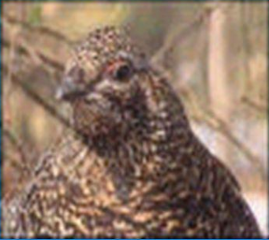
Is one of the largest reserves in Russia, including a significant part of the Teletskoe lake basin and the diverse landscape of the adjoining mountains. Altai reserve was established in April 1932 In 1998, the reserve received the status of UNESCO world natural heritage in nomination "the Golden mountains of Altai".

Slide 3
Species diversity of vegetation due to difficult terrain, the difference in climatic conditions. On the present territory of the reserve is marked:
1480 species of vascular plants
500 species of lichens
510 species of mosses,
more than 500 species of algae
Since the founding in the reserve found 16 species of fish, 70 types of mammals, 2 species of amphibians, 311 species of birds 7 species of reptiles
Endangered species: snow leopards, Altai mountain sheep argali, Golden eagle, bearded vulture, peregrine Falcon, Saker Falcon, osprey, black vulture, Altai snowcock and others.

Slide 4
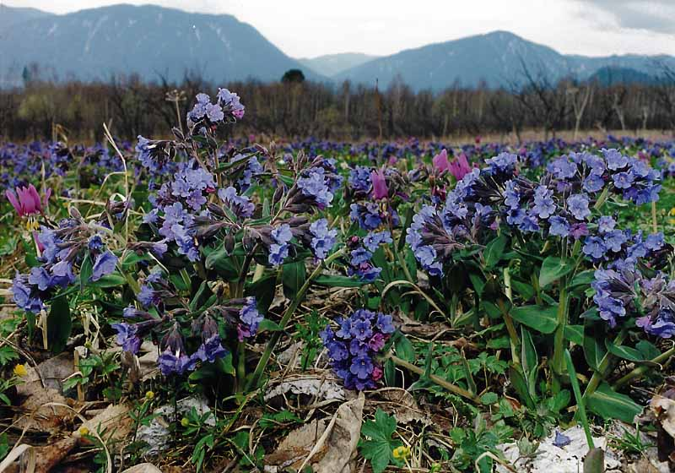
Макет двух объектов с таблицей

Slide 5
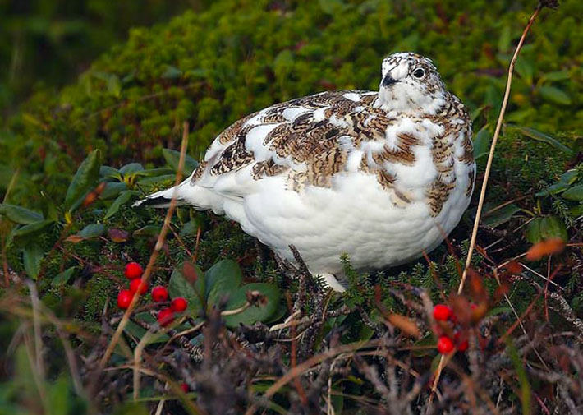
partridge

Slide 6
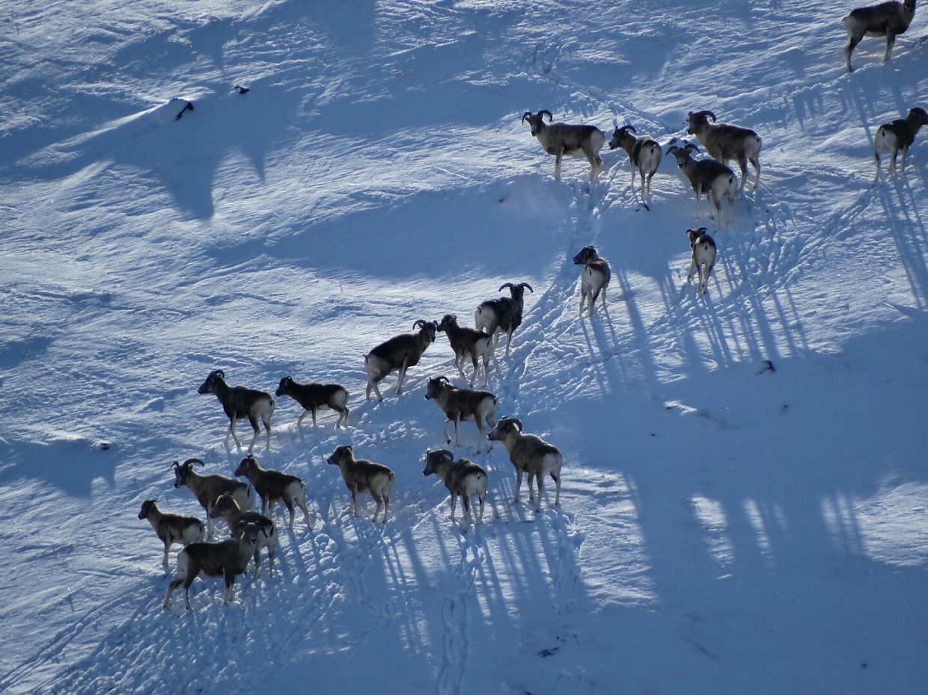
Добавить заголовок слайда - 1

Slide 7
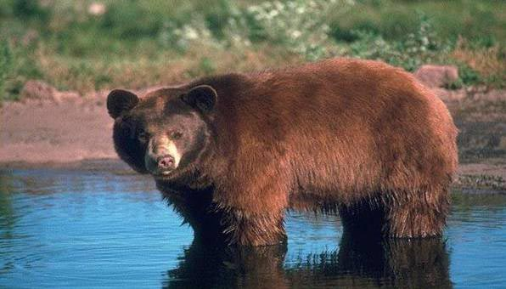
Добавить заголовок слайда - 2

Slide 8
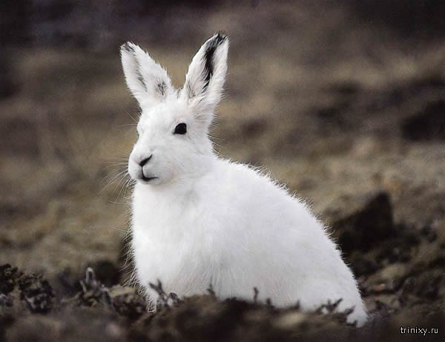
Добавить заголовок слайда - 3

Slide 9
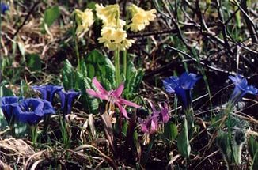
708×468

Slide 10
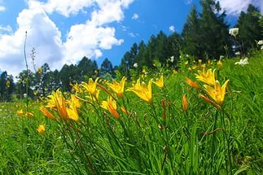
Добавить заголовок слайда - 4
1024×683

Slide 11
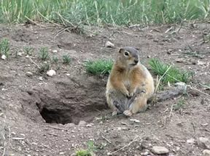
Добавить заголовок слайда - 5
750×563

