Slide 1
Dyakovo forest
complete: Charkovskiy Ilia, Tugushev Ramil’

Slide 2
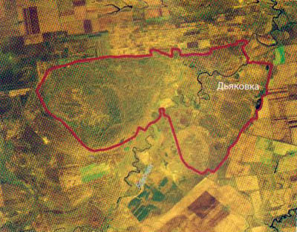
Neighborhood: Krasnokutsky
Category: Natural Monument
Profile: complex (landscape, biological)
Location: nature monument area covers the sandy plain between the rivers and Eruslan Bizyukov, Eruslan and Salt Cuba, floodplain and floodplain terraces p. Eruslan of latitude to. Dyakovka to the southern border area Krasnokutsk
Area: 17050.4 m

Slide 3
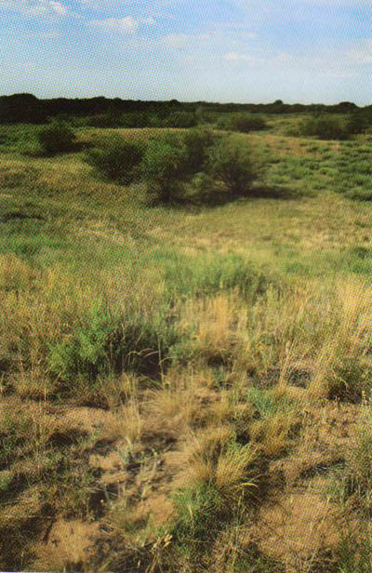
Short Description: Dyakovo forest is located on the boundary of the desert and semi-desert north. It is unique in the south-east of European Russia relic forest formed on the sands of the Khazar age in the post-glacial period. Sands as a result of tectonic uplift underwent deflation, redeposition and partial zakrepeleniyu woody and herbaceous vegetation.
Almost flat sandy plain surface occupied Vyazovo-maple and oak forests with shrubs: Russian broom, spiraea, rose in May, honeysuckle common, Amorpha fruticosa, hawthorn, blackthorn, low almond zhestera laxative, Blackberry bluish. Here, there are uneven planting of Scots pine. On the border of the array and the sandy terraces Eruslan thickets Elaeagnus angustifolia (ordinary)

Slide 4
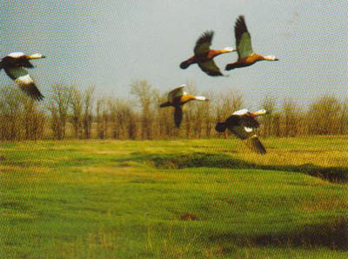
In a forest set to stay Dyakovo 165 bird species, of which for FROM noted reproduction. Among nesting on the number of species (57 or 50.4%) is dominated by representatives of the passerine group. The reproductive period in the floodplain habitat is dominated by Bluethroat. Background species at this time become a marsh and reed warbler, gray warbler, lesser whitethroat, common blue tit, great tit, tree sparrow and others.

Slide 5
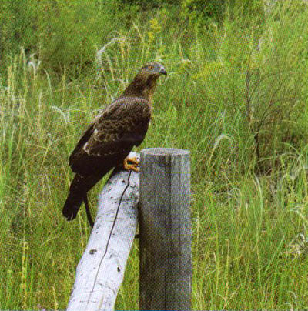
One of the characteristic features of bird of the forest - a significant part in the structure of birds of prey. Alternation of woody vegetation and open spaces is an optimal combination of conditions necessary for the habitat of these birds. Everywhere are seen common kestrel, the black kite and Montagu's Harrier; in the floodplain. Eruslan widespread marsh harrier. In Dyakovo common forest goshawk, two known regular breeding area White-tailed Eagle and Booted Eagle, Levant Sparrowhawk recorded regularly, rarely - Saker. The elm planting colonial nesting falcon, and in young pine plantations found several nests Swoop.
In Dyakovo forest revealed a settlement of other animals that are recommended for inclusion, and has listed in the regional Red Data Book. Among them are representatives of the reptiles: colorful lizard and steppe viper. From mammals here, along with the Red Book species inhabit shrews (small, plain), leather two-tone, wolf, fox ordinary, Korsak, marten stone, weasel, American mink, hare, birch mouse steppe, hamster ordinary, hamster Eversmann, slepushonki ordinary, lemming steppe, muskrat, vole water, common vole, Eurasian harvest mouse, and others.

Slide 6
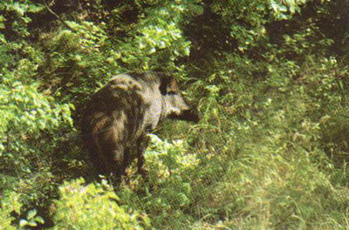
Specially protected objects
natural complexes Saltovskoe-Dyakovo sand massif and their components.
The plants listed in the Red Book of the Saratov area: the white birch, licorice, Fritillaria Russian, dodartiya East, anacamptis coriophora, orchids marsh Dactylorhiza meat-red, Trostyanka ovsyanitsevidnaya, barley korotkoosty, Atraphaxis shrub, ofayston odnotychinkovy, Dawn plain, cross the meadow, Franken zhestkovolosistaya, toadflax fragrant, Serpukhov chertopolohovaya, white water lily.
Animal species listed in the Red Book of the Saratov area: the hedgehog eared, ferret steppe, badger sand, ground squirrel yellow, jerboa small, demoiselle crane, ferruginous duck, ruddy, shelduck, white-tailed eagle, Pallid Harrier, Levant Sparrowhawk, booted eagle, steppe eagle, saker, bustard, little bustard, stone curlew, curlew, black-tailed godwit, Marsh Sandpiper, stilt, Black-Winged Pratincole.

Slide 7
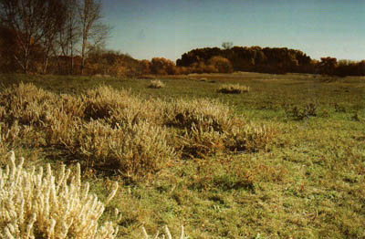
Arming
prohibited all kinds of cutting, other than thinning, construction of roads and other communications, construction, device landfills and littering the territory, disordered recreation, travel and parking car and tracked vehicles, except for the special; plowing (except fire opashki), grazing of livestock and: other fork of economic activities and natural resources, preventing the conservation, restoration and reproduction of natural complexes and their components.

