Slide 1
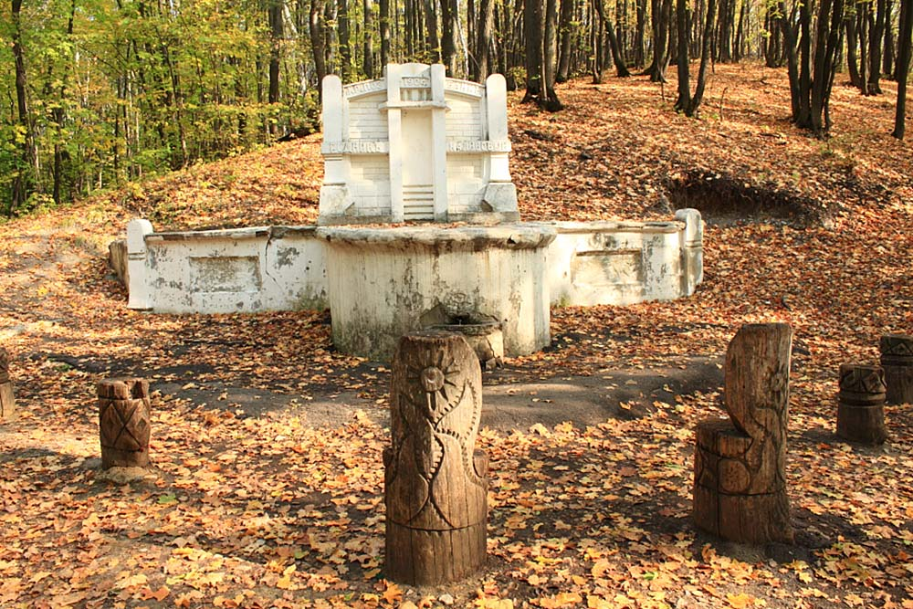
V Межрегиональный конкурс творческих работ обучающихся и педагогов «Здоровая нация – процветание России» Raspberry spring
Презентация на английском языке
Шокобасовой Айлины,
учащейся МОУ «СОШ с. Тепловка Новобурасского района Саратовской области»
Руководитель Кожохина Мария Анатольевна

Slide 2
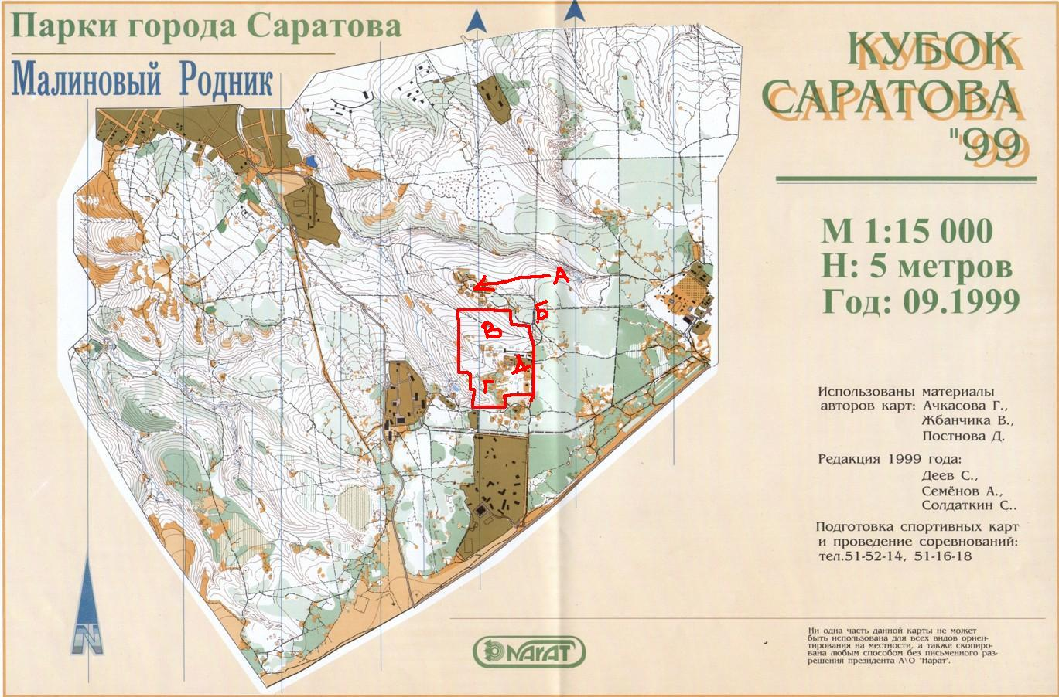
I live in Saratov Region, so I want to tell you about a famous spring - Raspberry Spring. Raspberry spring is quite popular among residents of Saratov. Many people comes here for the water, which is characterized by high taste properties and fully complies with hygienic requirements.
The source is located in the natural Park "Kumysnaya Polyana" which is in the region of 10-th Dachnaya Stop (Raspberry Gully).
Spring produces 1.5 m³ of pure cool water per hour. Every day hundreds of people come here to get some water or just to drink and to wash after a long journey.

Slide 3
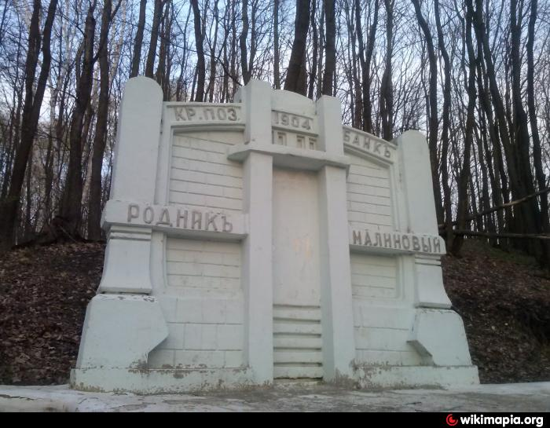
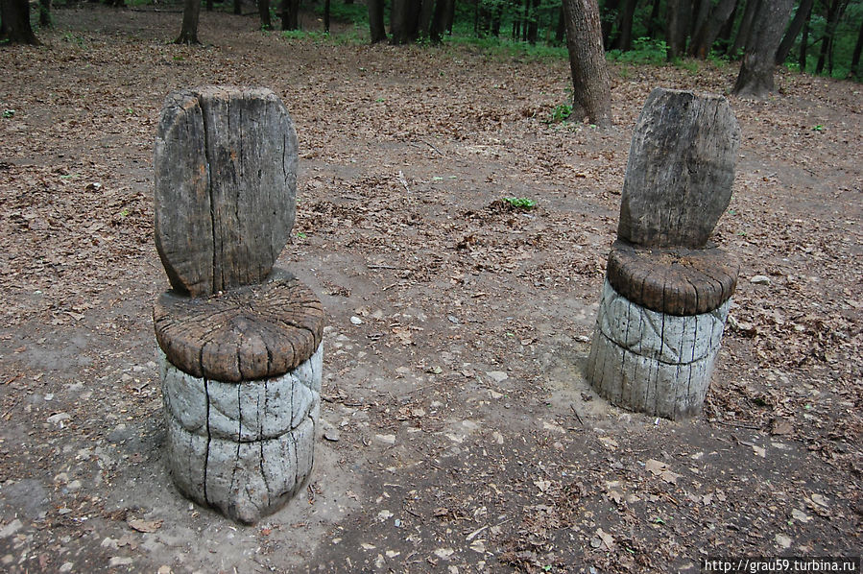
Raspberry Spring has a rich history. Its name is connected with many legends. It is known that the spring was appointed first in 1914, the Peasant Land Bank, which rented plots to rich merchants and officials.
Many years have passed, the spring was in need of renovation and the famous Saratov sculptor Victor Belozerov and his sons made it. They changed completely both the appearance and the entire hydraulic system of the spring.

Slide 4
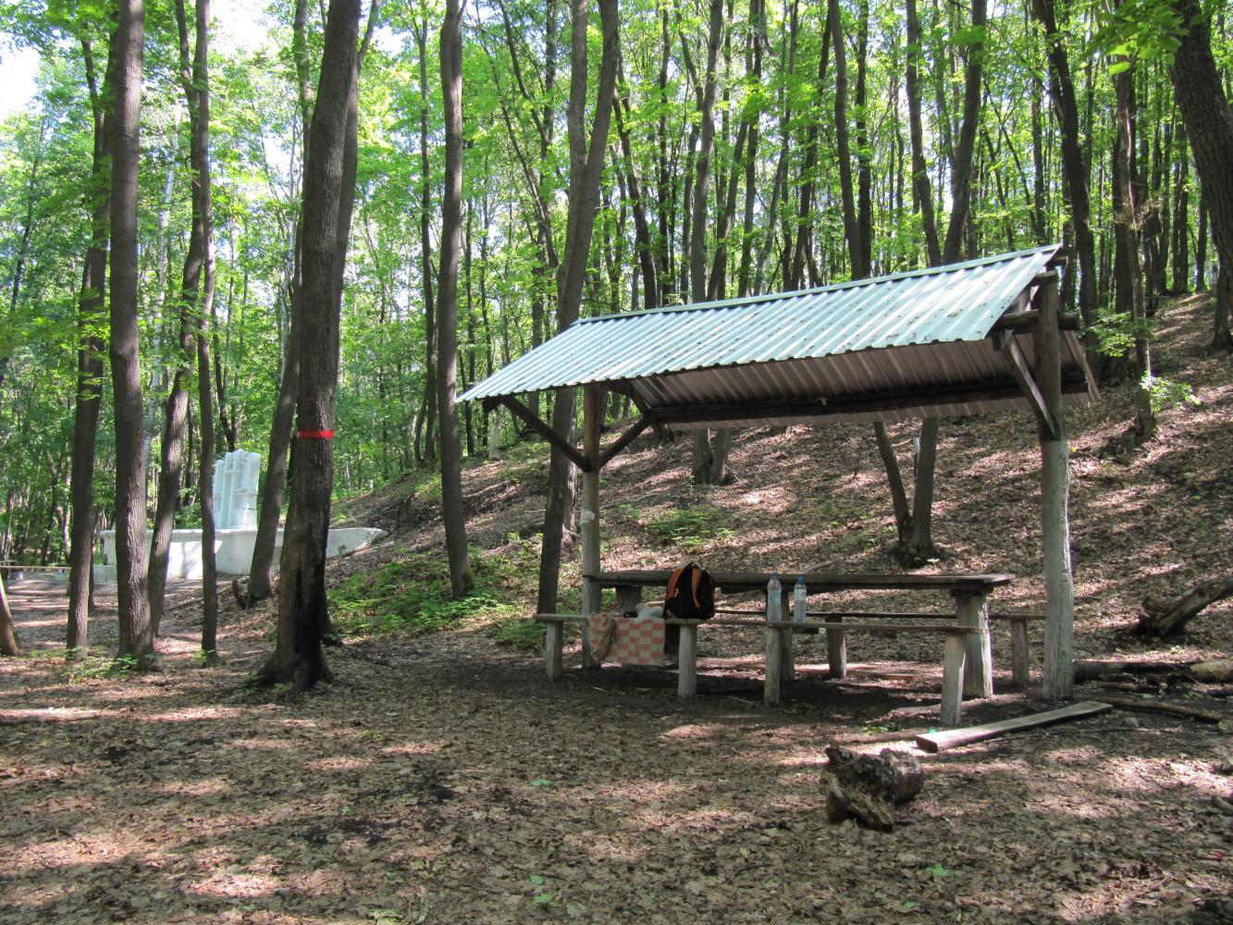
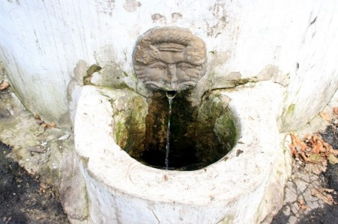
The forest here is particularly pristine and dense because of the abundance of moisture and not frequent appearance of a man (people don't usually go into the woods far from the spring and the road).
In this part of the forest you can find a lot of large “grapes snails", which were brought here sometime before.
Impressive and huge trees growing along the stream, giant willows, more than hundred years old make this place attractive and magnificent.

Slide 5
Resources
http://www.saratovgreen.ru/index.php?article=6&option=com_kb&task=article
https://yandex.ru/images/search?text
http://www.saratovgreen.ru/component/option,com_kb/task,article/article,6/

