Slide 1
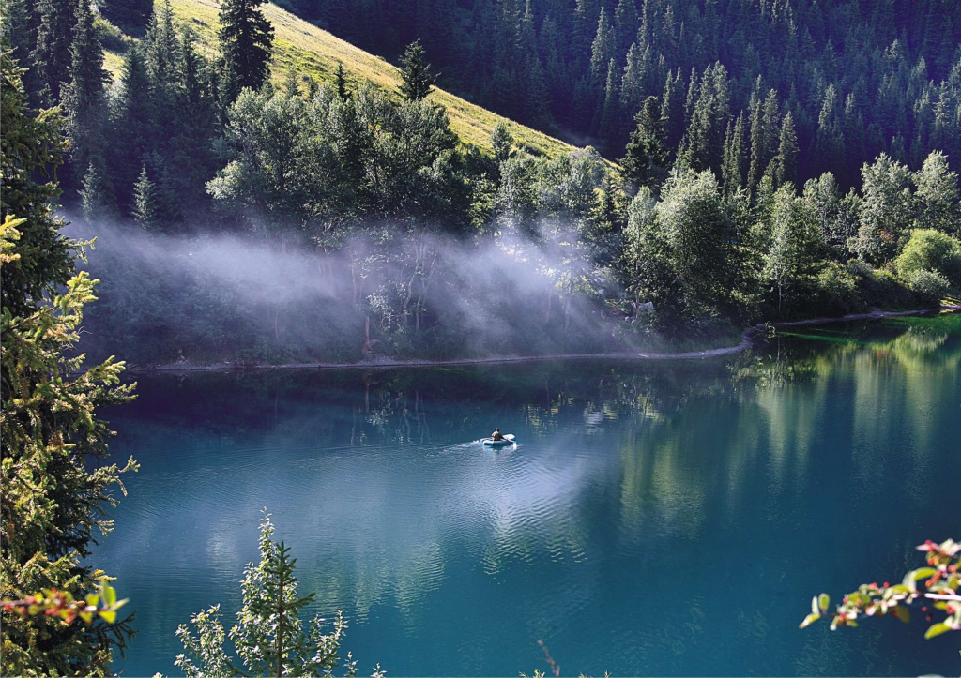
The Pearl of Kazakhstan
V Межрегиональный конкурс творческих работ обучающихся и педагогов «Здоровая нация – процветание России»
Презентация на английском языке
Хрипко Виктории,
учащейся МОУ «СОШ с. Тепловка Новобурасского района Саратовской области»
Руководитель Кожохина Мария Анатольевна

Slide 2
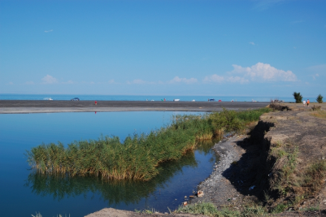
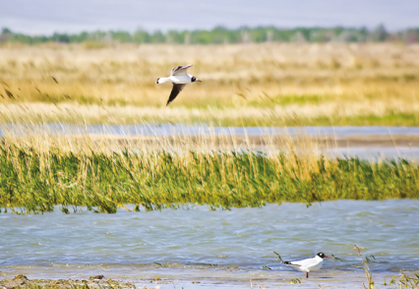
Introduction
I came from Kazakhstan, a country where there are a lot of national parks. One of them is Alakolsk National Park, a wonderfull place to visit. I visited it last year and I’d like to tell you about it.

Slide 3
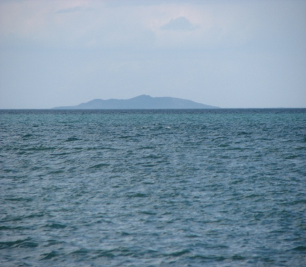
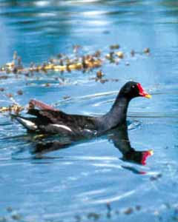
Locatoin
Alakolsk Natural Park is situated in Alakolsk District in the area of Alma-Ata Region and Eastern Kazakhstan Region.
When we were there we were told that Alakolsk Natural Park was founded by the Resolution of Kazakhstan Government in April, 1998 on the territory of the state reserve “Relictovaya Chaika”.
Hunting and fishing are forbidden on its territory.

Slide 4
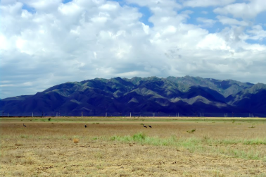
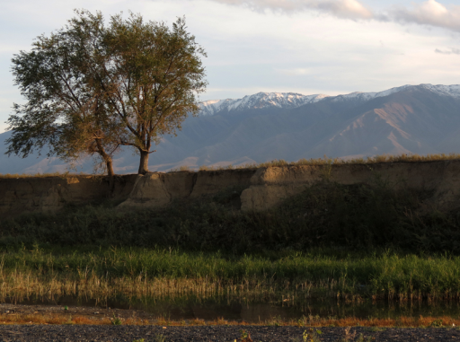
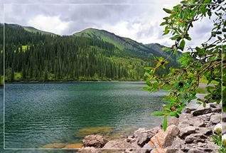
Landscape
I got to know that the landscape of the park is formed with a terraced plane and some lakes.

Slide 5
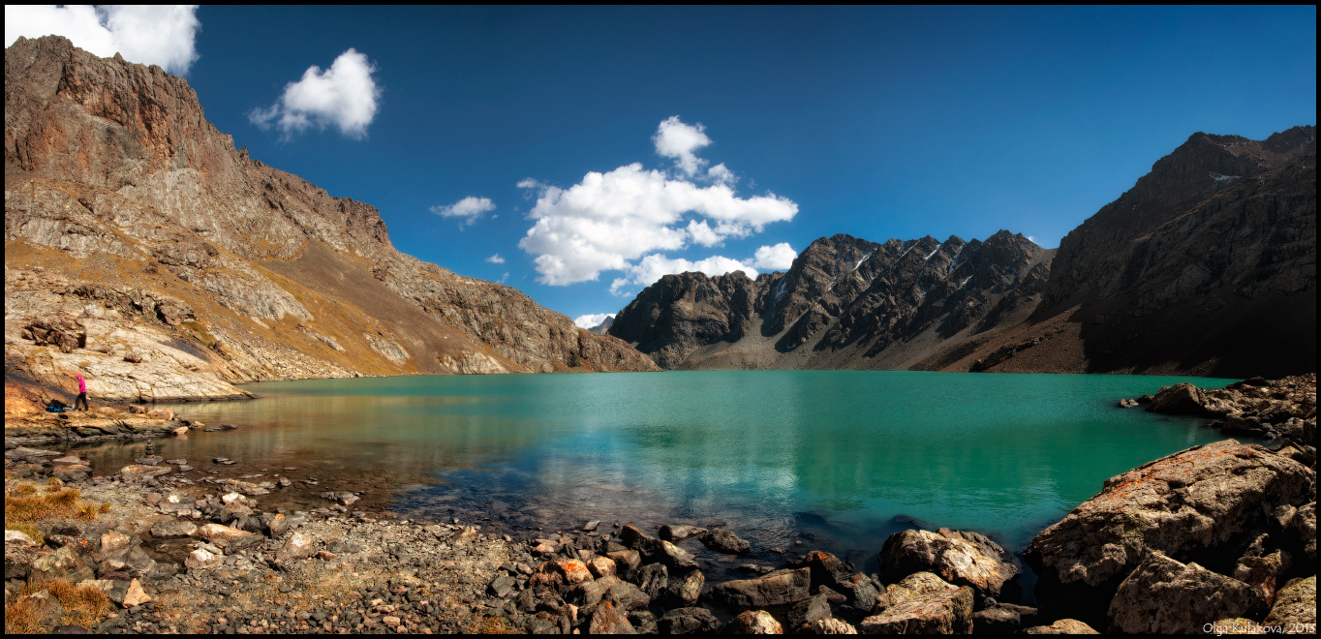
Lakes
The lakes occupy the territory between the mountains: the Dzhungar Alatau and the Tarbagatai in the south-east of Kazakhstan. In the centre of the hollow there are some large lakes: the Sasykkol, Uyaly and Alakol.
Lake Alakol is unique. It is situated 347 m above sea level.

Slide 6
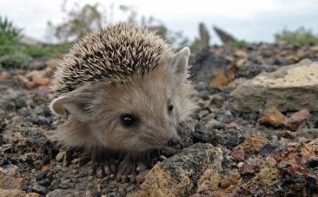
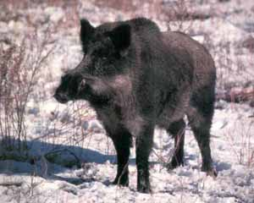
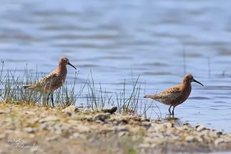
Nature
The wild world of the park is rich and wonderful.
There are 24 species of reptiles, 22 species of fish, 269 species of birds, 63 species of mammals, about 1000 species of insects and 2 species of amphibians.

Slide 7
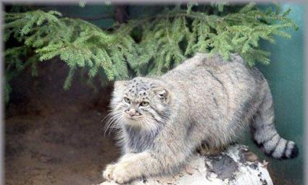
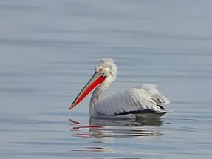
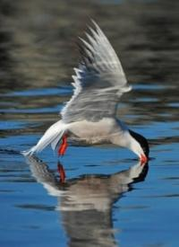
Rare birds and animals
In Alakolsk Natural Park some very rare animals and birds live.
Among them are the pink pelican, the great bittern, the small bittern, the great baklan, the bastard, the jaran, the manul and some others.

Slide 8
Resaurces
https://yandex.ru/images/search?img_url=http%3A%2F%2Fwww.silkadv.com%2Fsites%2Fdefault%2Ffiles%2Fstyles%2Farticle-teaser%2Fpublic%2F2-min_3.jpg%3Fitok%3DANgBfVZZ&p=16&text=алакольский%20заповедник%20казахстан&noreask=1&pos=670&rpt=simage&lr=47
https://ru.wikipedia.org/wiki/Алакольский_заповедник

