Slide 1
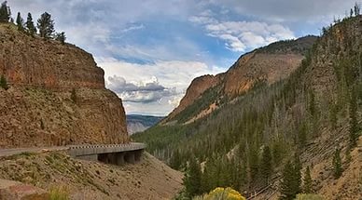
The First World National Park
V Межрегиональный конкурс творческих работ обучающихся и педагогов «Здоровая нация – процветание России»
Презентация на английском языке
Мусаевой Ниджар,
учащейся МОУ «СОШ с. Тепловка Новобурасского района Саратовской области»
Руководитель Кожохина Мария Анатольевна

Slide 2
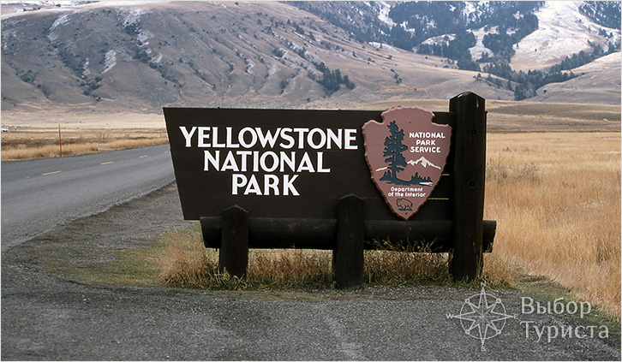
Visit Card
Yellowstone national Park (Yellowstone National Park) – the world's first national Park is situated in the USA.
The Park, founded March 1, 1872, has an area of 898 ha. It is famous for the amazing scenery and picturesque landscapes.
The Park was declared as a part of World Heritage by UNESCO.
The lakes, rivers, beautiful waterfalls, canyons and caves, pine forests give the special beauty of the area .

Slide 3
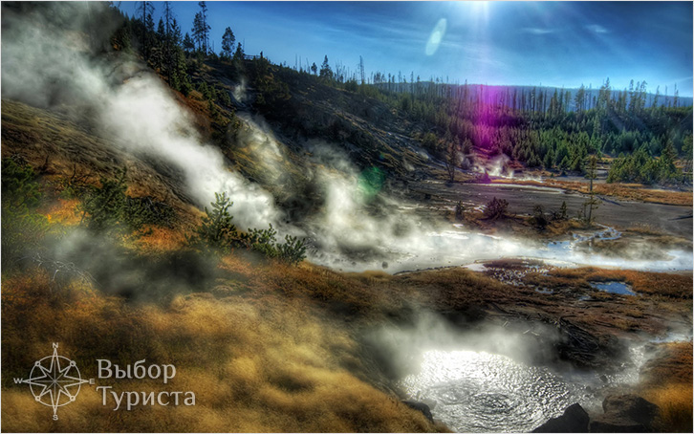
The Formation
Approximately 640 thousand years ago when the North American continent “was jumping" from earthquakes and volcanic eruptions in the Rocky mountains region a giant crater with an area of 2 000 km² was formed. Then it turned into a plateau.
Today's it’s the territory of bubbling molten mass, geysers, fumaroles, hot springs and mud fountains. It is called as "The country of water and smoke" or the lost world.

Slide 4
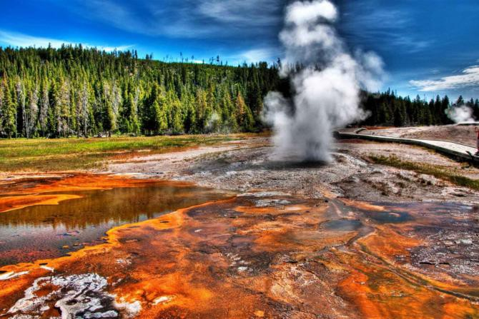
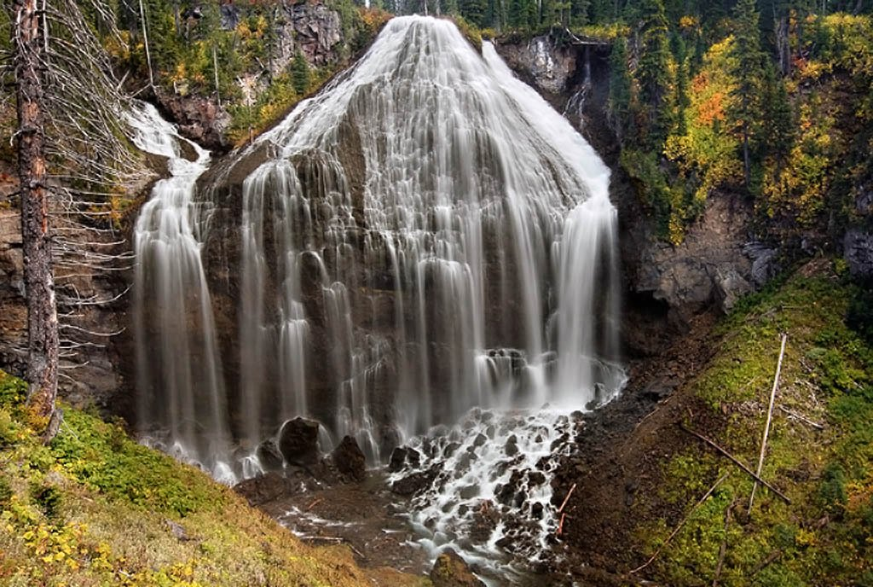
Picturesque Nature
In Yellowstone National Park, having an almost square shape, there are 5 roads and it is accessible to sun light from all sides.
In the northern part, where there is geological chaos, are picturesque gorges, at the bottom of which theYellowstone river flows, The Range Madison, and hundreds of waterfalls falling into canyons.

Slide 5
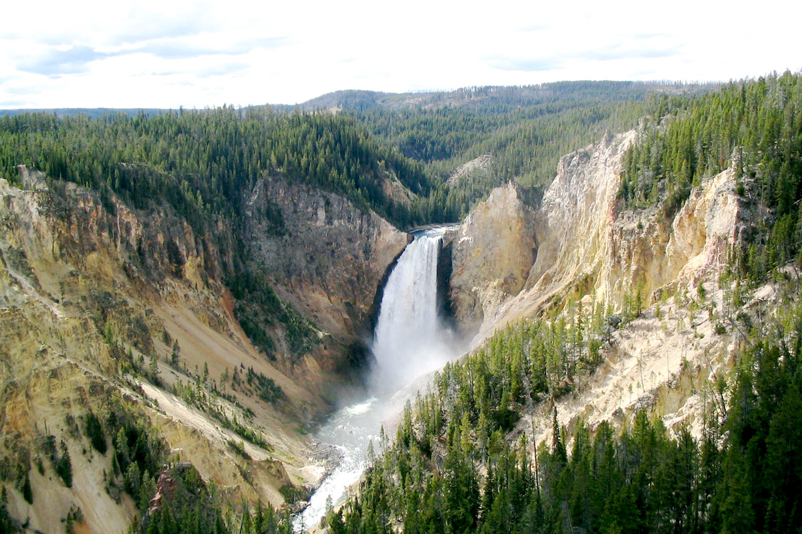
The largest of the falls – the Lower Falls, its height is 94 m!

Slide 6
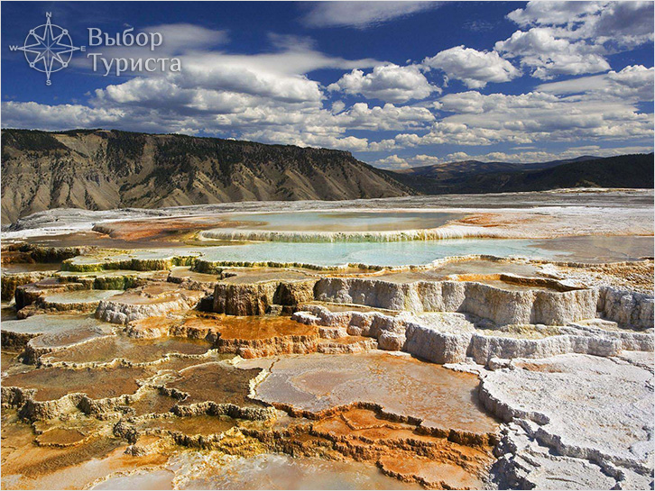
Huge hot springs
They are rich in calcite. Thousands of years calcium dissolved in hot water sources. Thus the picturesque, sparkling crystals terraces were formed , and steep slopes adorned with cascades similar to stalactites. It would seem that the amazing limestone pieces should be white, but some of them are colored in all shades of the rainbow spectrum.
There is an interesting fact of the microorganisms that live in hot water. Their color depends on water temperature, therefore, some terraces, brightly painted in blue-and-purple palette, and the other glowing in fiery-scarlet, and Canary-yellow.

Slide 7
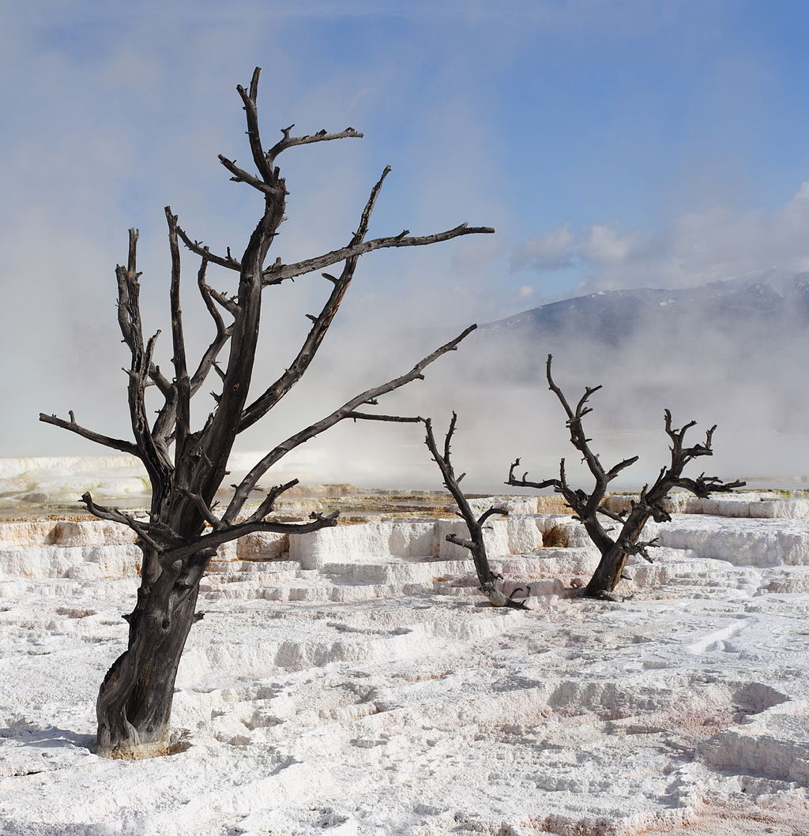
The world's largest petrified forest
You can see this beauty of nature in the north-east of the Park. With a slight eruption, which occurred several thousand years ago, ash covered trees, and they are mineralized, as in a fairy tale, turned into stone idols.

Slide 8
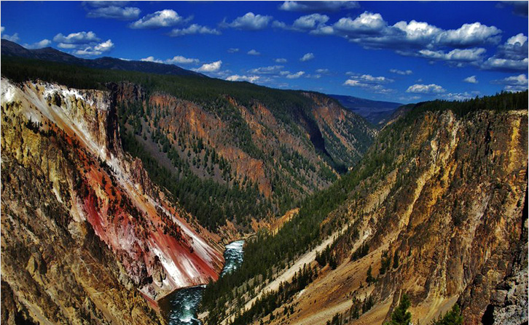
Grand Canyon
The Eastern part of Yellowstone opens local Grand Canyon.
Its depth is 360 m and length of 20 km! This is why the Park got its name – the sunlight reflected in the yellow rocks that make up the canyon walls.

Slide 9
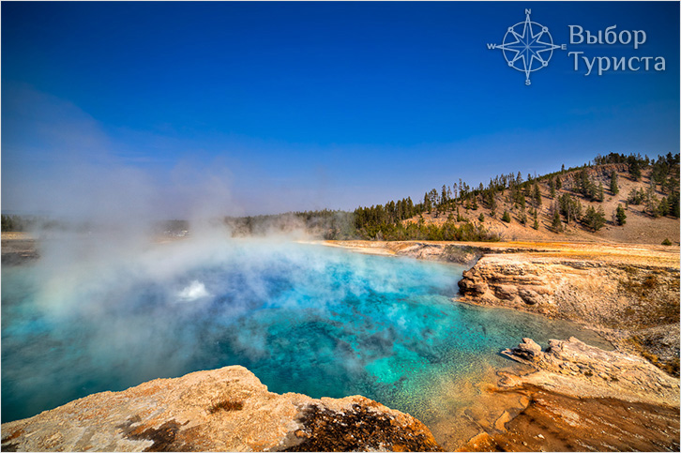
Geysers
One of the impressive geysers is Excelsior. It doesn’t come from under the ground, it is in the centre of the picturesque mountain lake.
The height of the fountain can reach 90 m, and the process is accompanied by special effects – roar, a roar and trembling of the earth beneath your feet.

Slide 10
Resources
https://ru.wikipedia.org/wiki/Йеллоустонский_национальный_парк
https://yandex.ru/images/search?text=парк%20йеллоустоун&stype=image&lr=47&noreask=1&parent-reqid=1486843150496097-1376260956090388392198656-sas1-1990&source=wiz

