Slide 1
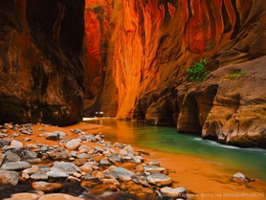
Attraction of Zion National Park
V Межрегиональный конкурс творческих работ обучающихся и педагогов «Здоровая нация – процветание России»
Презентация на английском языке
Шокобасова Ильдара
учащегося МОУ «СОШ с. Тепловка Новобурасского района Саратовской области»
Руководитель Кожохина Мария Анатольевна

Slide 2
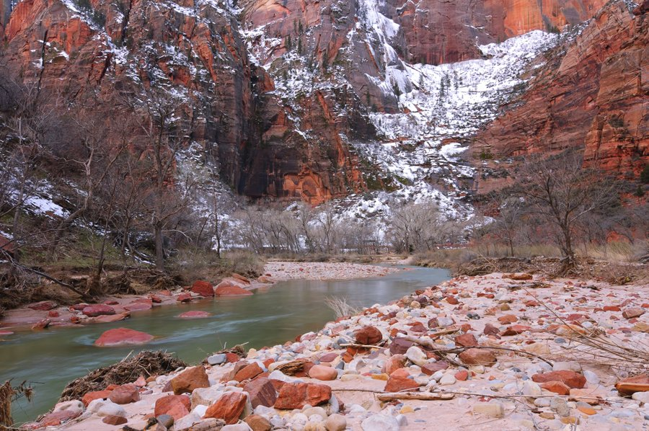
Zion national Park in Utah (Zion National Park, Utah), stretching for about 590 square kilometers, is famous by its ossified formations of red Sandstone. The main attraction is the Zion Canyon with the length of 24 km and the depth of 800 m. It is situated on the northern bank of the River Virginia in the region of Navaho Sandstones, which are of reddish and bronze colors.
In the 19th century the first Mormons settled these parts, and called the fancy shapes of the slopes of the canyons as "natural temples of God".

Slide 3
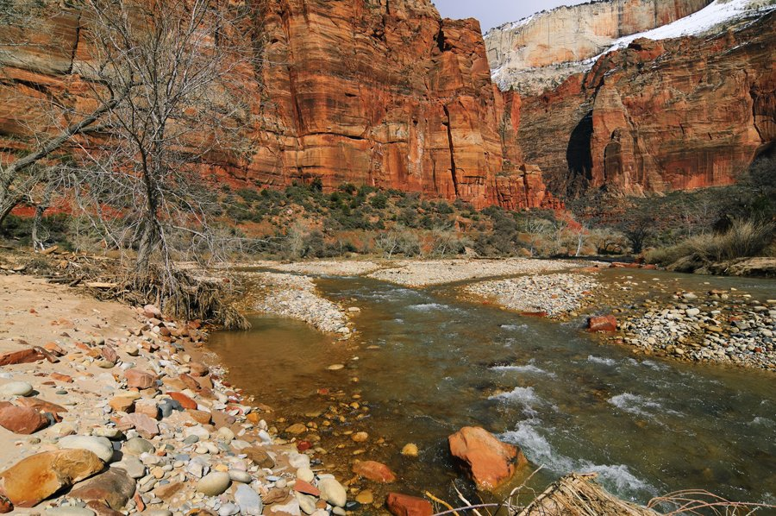
Creation of the national Park
In 1909, US President William Taft gave tothis place the status a national monument to preserve the canyon. It was called as “National Monument Mukuntuweap".
However, in 1918, the acting Director of the newly created national Park Service renamed the Park in Zion (Zion).
The U.S. Congress has legalized the status of a national Park November 19, 1919. Located in the north-west Kolob Canyon was proclaimed as a “National Monument Zion" in 1937, and in 1956 it was United with the Zion National Park.
Before the creation of the national Park, tourism in this area was slightly developed because of the long distance and lack of service. Since 1910, old railways had been converting to highways, and in 1917 the road in Zion Canyon was built.

Slide 4
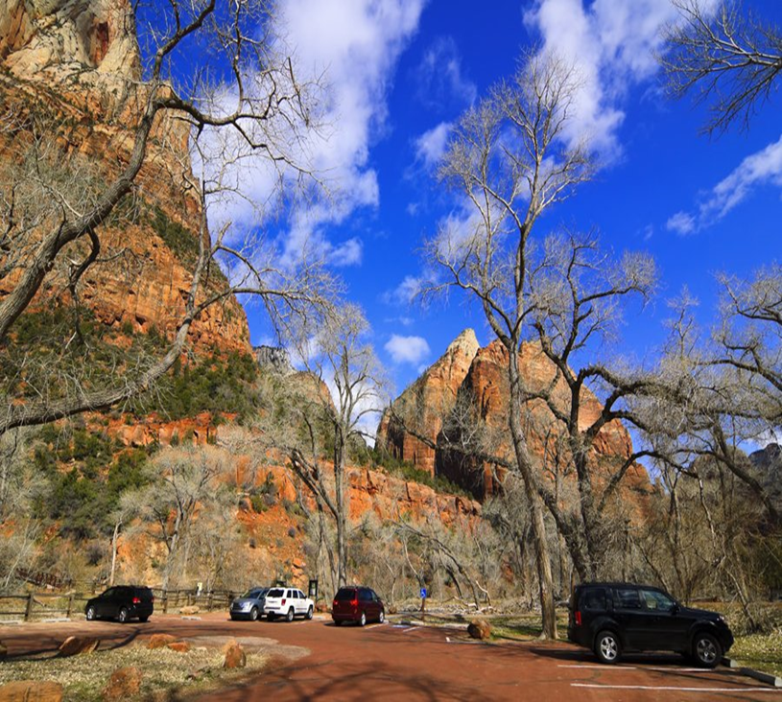
Zion Canyon
The road to Zion Canyon, its length is about 10 km, ends at the Temple of Sinawava (the name of the God of the Indian tribe of Paut). After the Church the road becomes narrow, and then there are some walking trails to the gorge Zion Narrows with the width of 6 m and the height of 600 m.
From the beginning of April to the end of October, because of busy traffic on the road, Zion Canyon is restricted. there are Free buses moves regularly on it. The rest of the year the road is open to private vehicles.
The entrance to the Park is on its Eastern side with road highway 9 of Utah State, from Mount Carmel. The road goes through a tunnel. The most notable attractions of the Park on the Eastern side are Checkerboard Mesa and East Temple.

Slide 5
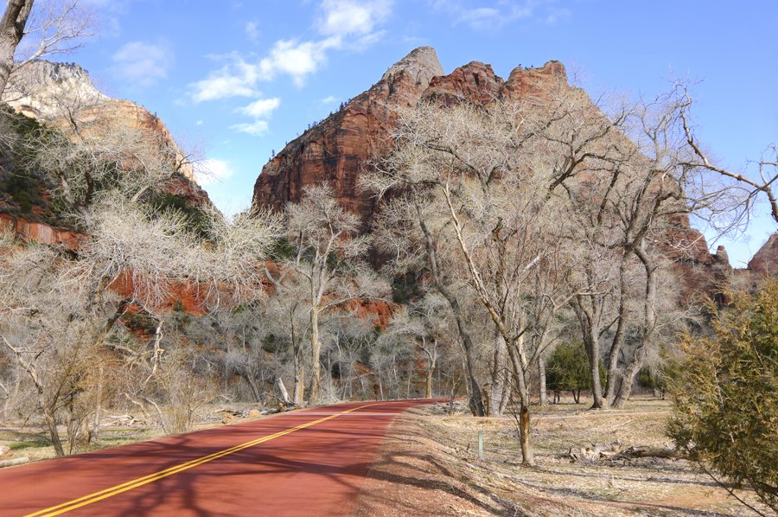
Canyon Kolob
The main feature of Canyon Kolob is that unlike other places of the Colorado Plateau, its layers are not horizontal, but under a large slope. It is connected with the geological stresses and deflections that occurred before the Colorado Plateau was formed.
The road goes high in the mountains, the temperature is rather lower there so it also influence the vegetation.

Slide 6
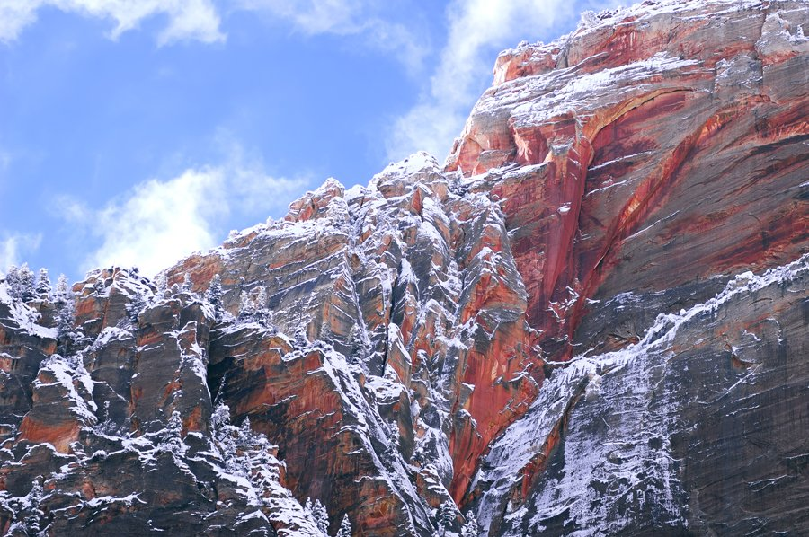
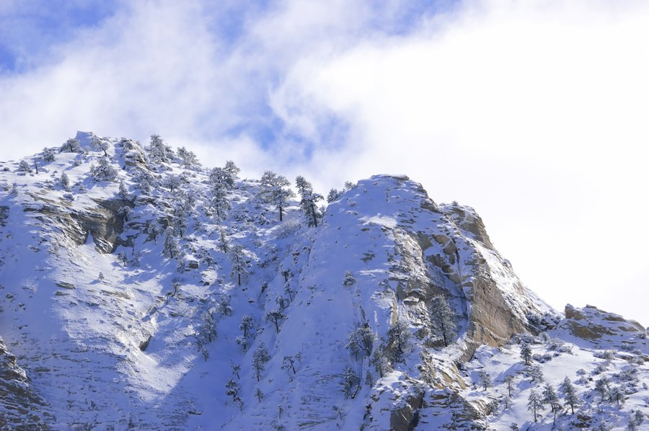
Mountains
Zion national Park is an amazing collection of rock formations, carved mainly from the main local breeds of Navaho Sandstone. The captivating high cliffs, dark rocks and deep pits, glittering in all colors, from flaming red to a soft pink. There is
glittering snow on the tops in winter.

Slide 7
Resources
http://loveopium.ru/severnaya-amerika/park-zajon.html
Https://ru.wikipedia.org/wiki
https://yandex.ru/images/search?text=заповедник%20зайон&img_url=http%3A%2F%2Fredrockexpress.dreamhosters.com%2Fwp-content%2Fuploads%2F2015%2F12%2Fbigstock-landscape-from-zion-national-p-72796747.jpg&pos=1&rpt=simage&stype=image&lr=47&noreask=1&parent-reqid=1486839389127392-4431492578579862641191014-sas1-5484&source=wiz

