Slide 1
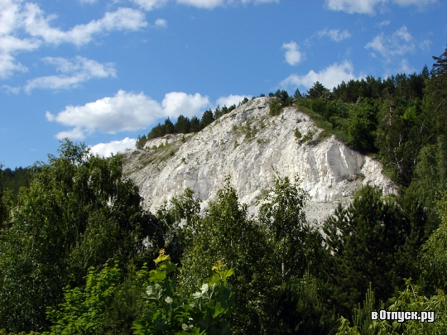
Khvalynsk National Park, the Territory of Wonderful Nature
V Межрегиональный конкурс творческих работ обучающихся и педагогов «Здоровая нация – процветание России»
Презентация на английском языке
Субботкина Никиты,
учащегося МОУ «СОШ с. Тепловка Новобурасского района Саратовской области»
Руководитель Кожохина Мария Анатольевна

Slide 2
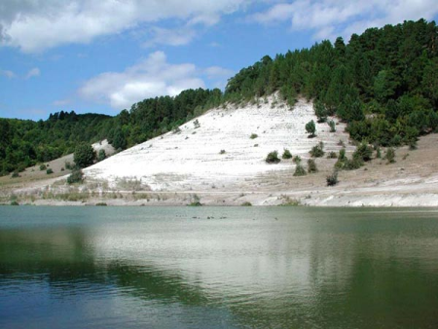
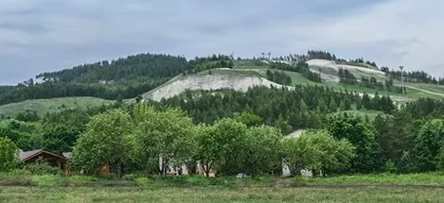
Location
National Park "Khvalynsky" is in Chvalynsk district, in the north-east part of the Saratov region. It was created by the resolution of the Government of the Russian Federation of 19 August 1994.
The initial area was 25 514 ha and included forests of the state forest Fund. The resolution of the Government of Saratov region from April 23, 2004, established a protected zone of the national Park. It was 114 924 ha without seizure of land from semicontinental. The today total area of the park is 140 438 ha.

Slide 3
Chvalynsk National Park on the map
Khvalynsky park

Slide 4
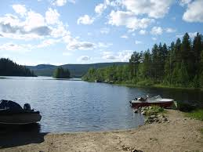
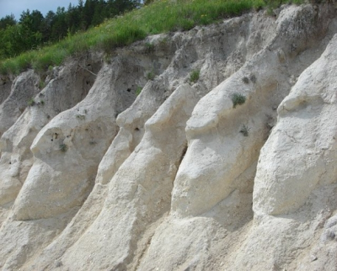
Geographical Position
The territory is located on one of the highest hills on the Volga Khvalynsk Mountains. The greatest peak is 369 m.
The General nature of the terrain elevated, undulating and hilly. Numerous ravines, gullies and valleys (tract Bogdanikha, Mountain Dolgaya, Ogurtsovo, beam Tyurin Dol, Fedorov Dol, and etc.) divide the territory into several watersheds of the lower order peaks: mountain Kalka (285 m), Belen’kaya Mountain (345 m), Mount Tashi (309 m), Mountain Bogdanikha (237 m), Mountain Barminskaya (340 m), Mordovskaya shishka (267 m).
Tops and slopes of mountains are covered with forests. The soil cover is very diverse. Bedrock (chalk, marl) often appear on the surface.

Slide 5
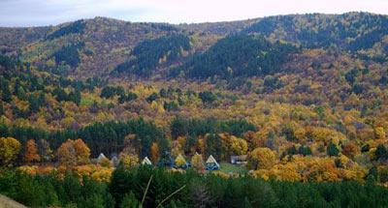
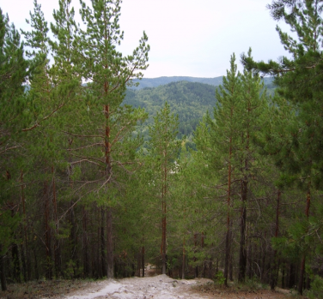
Climate
In this area the climate is continental with large annual and daily fluctuations of air temperature. In January the average temperature is -13°С, in July - +21°С.

Slide 6
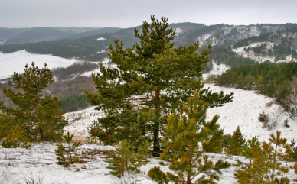
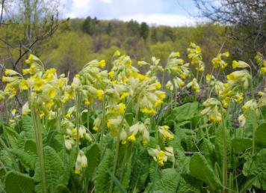
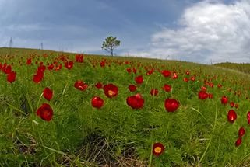
Plants
This area has a huge variety of vegetation. The national Park "Khvalynskiy" is rich of pine and oak forests.
Park "Khvalynskiy" has 21 species of plants that are relicts and endemics. They are all registered in the Red Book of the Russian Federation. Some of them are solankowa wormwood, fragrant matthiola, fine-leaved peony, Volga cinquefoil, several species of feather grass.
There are also some relic ferns. Here grow rare species of tulips, lillies, violets. Some of them are included in The International Red Book.

Slide 7
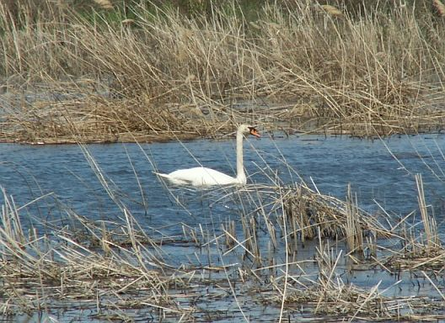
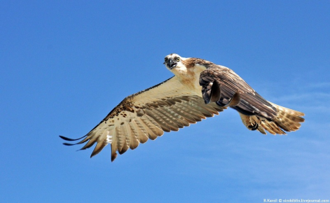
Birds
The fauna of the Park is rich and different.
There are sixteen insect species and 15 species of reptiles and amphibians. For example, the adder of St. Nicholas, and the Steppe Viper which are included in the Red Book of the Russian Federation.
The world of birds in the park is particularly rich. There are 165 species of birds. For 113 of them this place is home. Nesting species include many passerine birds. You can see great bustards, buzzards, red-footed falcons, some species of geese, swans, woodpeckers, eagle owls and others.
The forests are home to the Sparrow hawk and Goshawk, the white-tailed eagle. Every year in the Park is recorded the nesting of rare birds, and the Golden eagle is assumed here to breed.

Slide 8
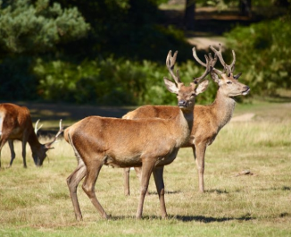
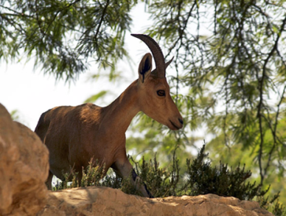
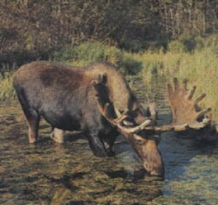
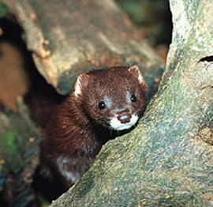
The protection of animals
The national Park "Khvalynskiy" has a number of priorities. The most important of them - the protection of the animal world. Every year there are biological activities that improve the quality of land, increase the number of animals. New feeding grounds are regularly repaired and made, everything is done to prevent the death of animals. Constantly the distribution and abundance of animals is being monitored .
National Park "Khvalynsky" is – a protected area where hunting is prohibited completely. Only recreational fishing is allowed.

Slide 9
Internet-Resources
nphvalynskiy.ru
ru.wikipedia.org
fb.ru›article/194875/natsionalnyiy-park…flora…foto
https://yandex.ru/images/search?p=3&text=хвалынский%20национальный%20парк%20официальный%20сайт&img_url=http%3A%2F%2Fstatic.panoramio.com%2Fphotos%2Flarge%2F12493355.jpg&pos=144&rpt=simage&lr=47

