Slide 1
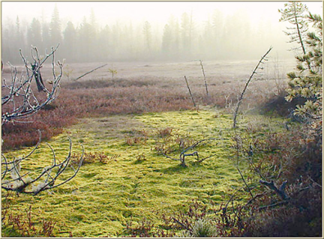
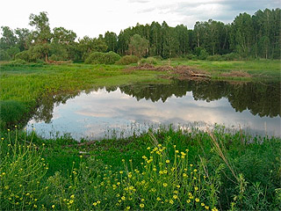
The Moss Swamp, a Relic Natural Monument
V Межрегиональный конкурс творческих работ обучающихся и педагогов «Здоровая нация – процветание России»
Презентация на английском языке
Тугушевой Нурии,
учащейся МОУ «СОШ с. Тепловка Новобурасского района Саратовской области»
Руководитель Кожохина Мария Анатольевна

Slide 2
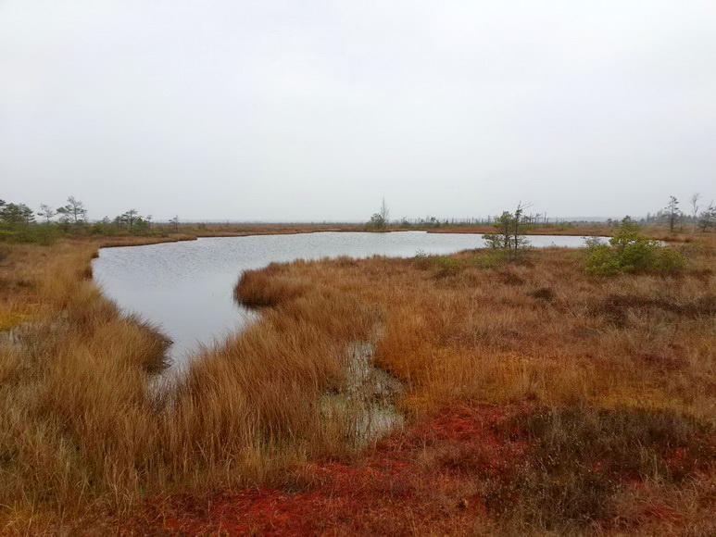
Our Saratov region has a well-known historical and natural monuments in Novye Burasy District. These monuments tell us about the past.
I want to tell you about the nature reserve of moss swamp, which is not far from the village Stantsiya Burasy.

Slide 3
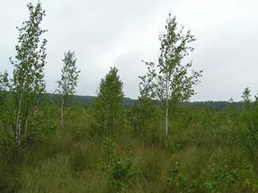
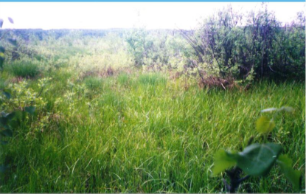
Moss swamp - a unique landscape complex of southern forest steppe of Saratov region and the entire southern forest steppe of the Volga Upland.

Slide 4
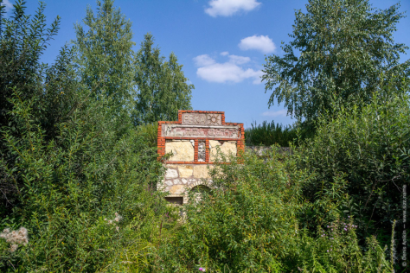
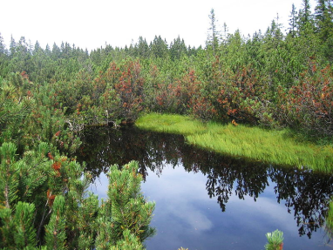
Natural microreserves "moss swamp" is located on the territory of Novye Burasy District between the villages Stantsiya Burasy and Ivanovka.

Slide 5
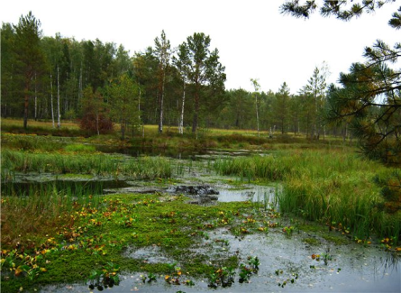
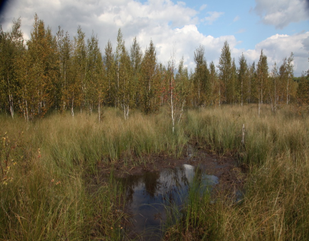
The swamp is surrounded by woodland, in which the main tree species are the common oak, birch warty, Tilia cordata. The grass layer present timothy grass, wild cornflower, and other plants.

Slide 6
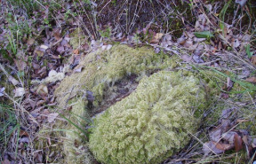
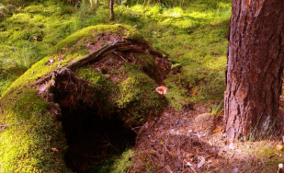
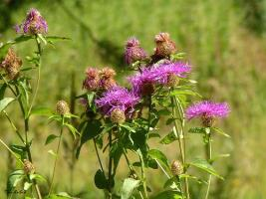
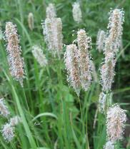
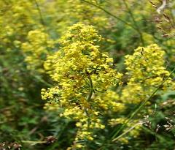
Flora
There is dense bubble sedge everywhere, somewhere there is Potentilla marsh bedstraw and many other marsh grasses. Within the reserve live about 150 species of birds, rodents, mammals and others.

Slide 7
Fauna
Within the reserve about 150 species of birds, rodents, mammals live.
Fauna forests immediately adjacent to the swamp is rich. It provides a variety of food resources and shelter. Faunistic composition of amphibians and reptiles wide environmental terms.
In forest areas with high moisture and significant development of grass cover moor frog lives. Here dwells the representative of the tailed amphibians - common newt. On the forest roads are common meeting green toad and common spade foot, at least in small forest ponds European fire-bellied toads can be seen.
Among the semi-aquatic reptiles largest grass snake dominate. There are also adders.
The lizard fauna is presented by a sand lizard.

Slide 8
Adder

Slide 9
Moor frog

Slide 10
Sand lizard

Slide 11
Birds
The birds world of the marsh and the surrounding area is very rich. Most of them are species of tree layer (gray crows, magpies, crows) and hollow-nesting birds (gray and red-breasted flycatcher, willow tit, great tit, colorful and small woodpeckers, black woodpecker, white-haired and white-backed woodpeckers, tawny owl, stock-dove). Widespread finches (chaffinch, goldfinch, greenfinch, lentils and grosbeak), use for nesting undergrowth and mature trees.
In winter, almost completely disappear insectivorous birds. Bird's population at this time supplemented by nomadic feathered from the northern regions of the country. Among the winter migrants are the most widespread siskins, common ash and tap dancing, bullfinches, less frequent and Yellow-Moskovka.

Slide 12
Oriole

Slide 13
Finch

Slide 14
Siskin

Slide 15
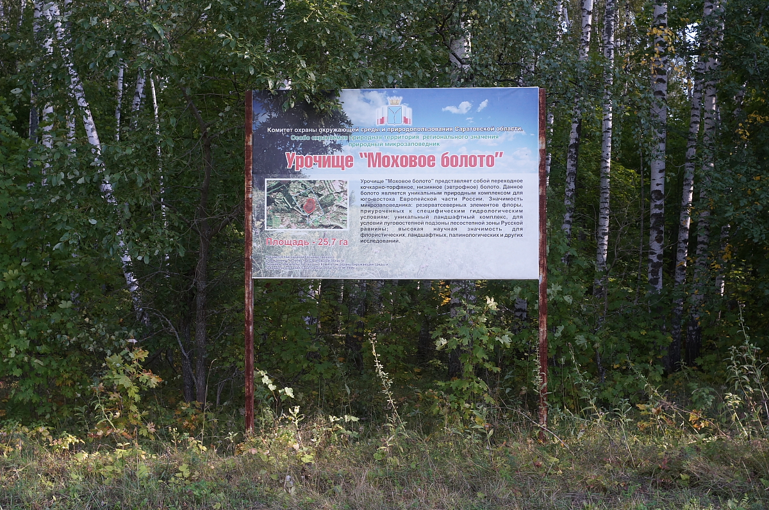
The Moss Swamp is the only monument of nature of the pre-glacial period and any human economic activity is forbidden on its territory.

Slide 16
Resources:
1. Protected Russia
2. Encyclopedia of Garden Plants
3. pitomets.ru
4. Science and life
5. Native environment
6. Wikipedia
7. ptic.ru

