Slide 1
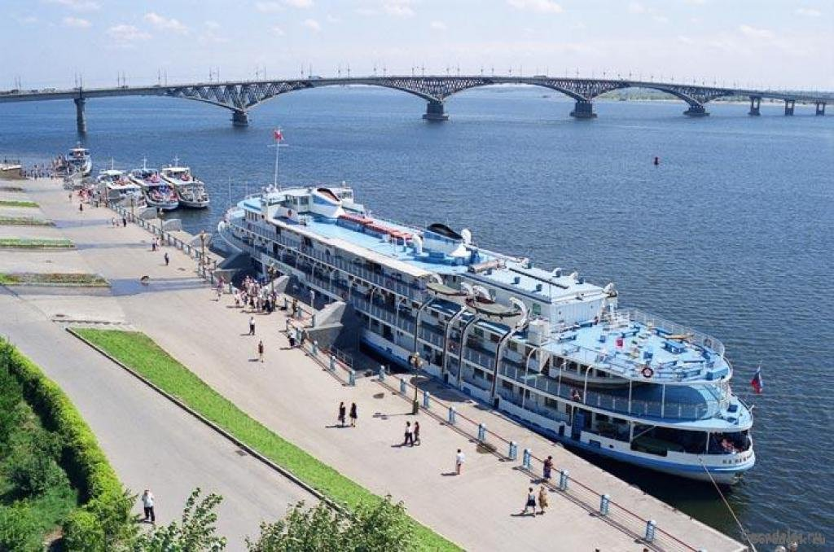
Презентация на английском языке Искендеровой Эллы, ученицы 5 класса МОУ «СОШ с. Тепловка Новобурасского района Саратовской области» руководитель Кожохина М.А., учитель английского языка МОУ «СОШ с. Тепловка Новобурасского района Саратовской области»
Региональный интернет-конкурс творческих работ
«Экологические тропинки»
Mother Volga

Slide 2
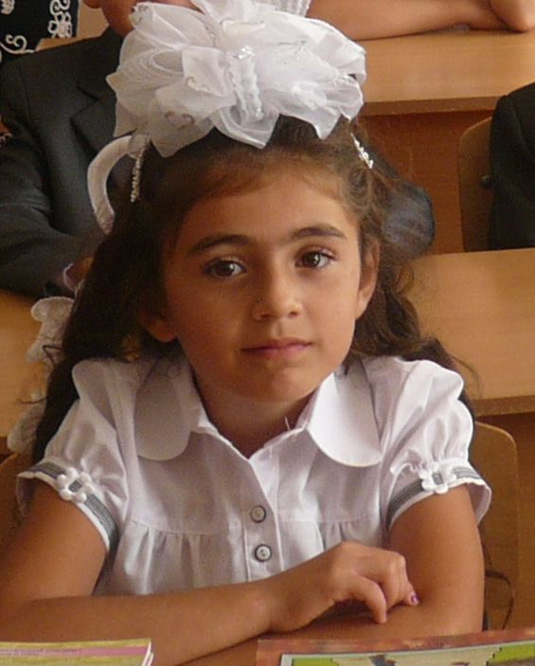
My name is Ella Iskenderova. I’m a 5th year student. I live in Tyoplovka, a village in Novye Burasy District. It’s in Saratov Region. My story is about the Volga River, the main and the biggest river of our native region.

Slide 3
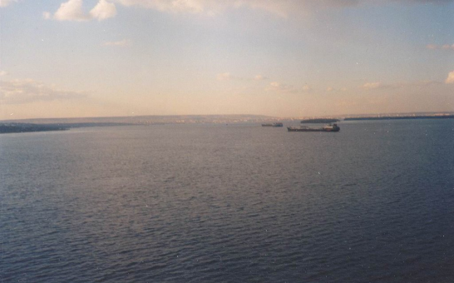
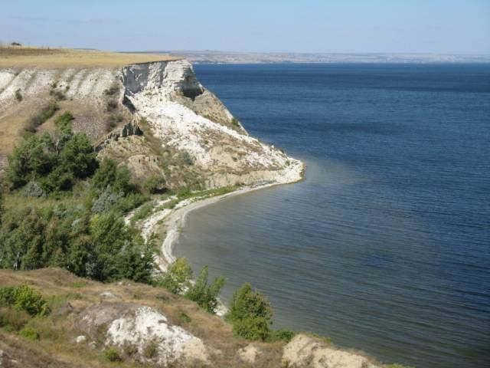
The Volga River is one of the longest rivers in the world and the longest river in Europe.

Slide 4
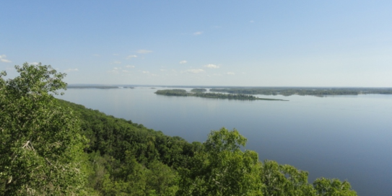
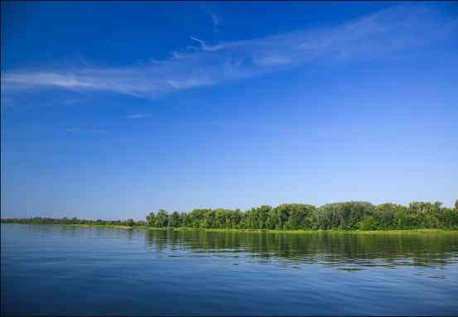
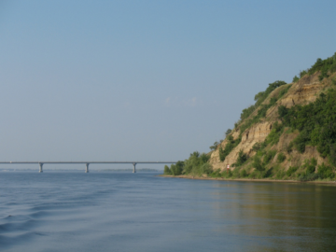
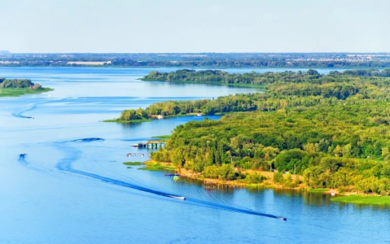
The Volga and its nature are very beautiful.

Slide 5
There are a lot of cities and towns on the Volga River. One of them is Saratov, the main city of our region.

Slide 6
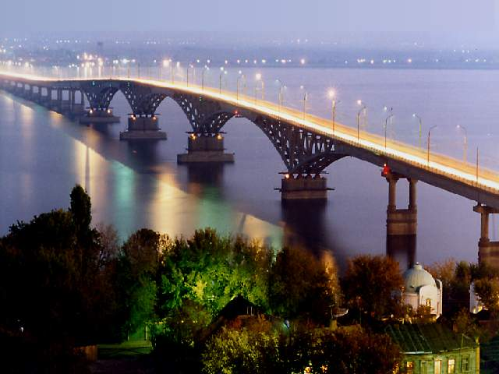
The Bridge across the Volga in Saratov is very beautiful. It’s one of the biggest bridges in Europe. It connects Saratov and Engels.

Slide 7
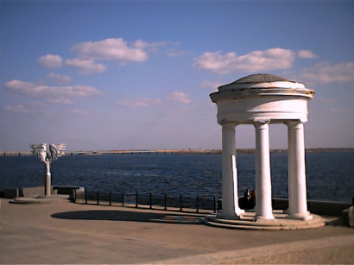
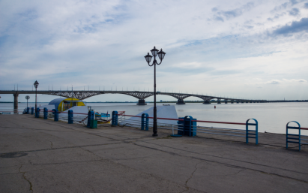
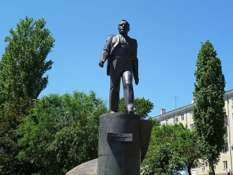
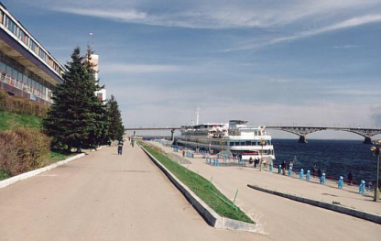
The name of the embankment in Saratov is Cosmonaut. You can see the Monument to Yuri Gagarin and the famous Saratov Rotunda. Tourists and visitors like to walk and have a good time there.

Slide 8
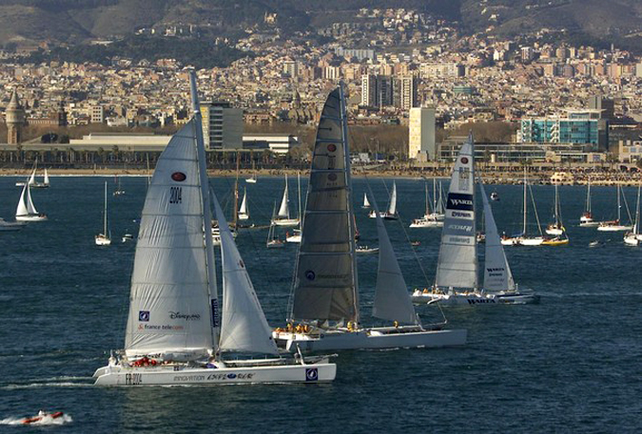
If you like sport you can go in for yachting in summer. It’s joyful!

Slide 9
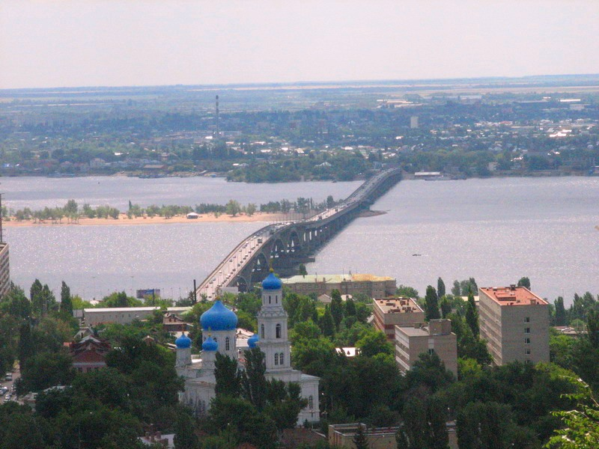
We can call the Volga Mother Volga. It’s long, powerful and beautiful. I like the Volga River, Saratov and my native village.

Slide 10
Internet Resources
волга википедия
волга саратов википедия
https://ru.wikipedia.org/wiki/Набережная_Космонавтов_(Саратов)
набережная в саратове википедия

