Slide 1
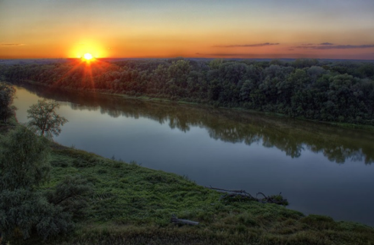
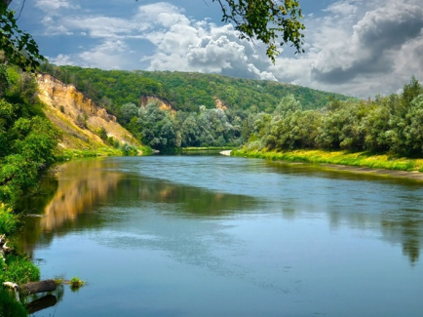
The Unique River Hopper
Региональный интернет-конкурс творческих работ
«Экологические тропинки»
Презентация на английском языке
Симонян Полины,
учащейся МОУ «СОШ с. Тепловка Новобурасского района Саратовской области»
Руководитель Кожохина Мария Анатольевна

Slide 2
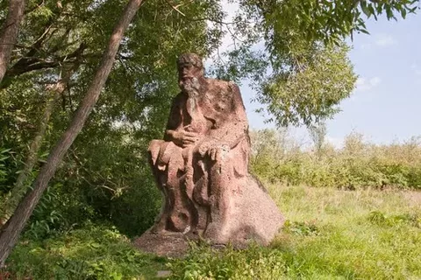
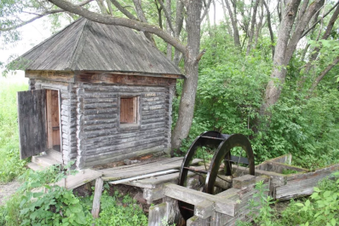
The legend
The Hopper rises from the central part of Penza Region, flows on Volga Upland to the south-west and then into the Don.
According to the legend there lived an old man Hopper. Once he walked through the steppe and saw twelve springs spurted from under the ground. The old man took a spade and connected all the springs in one. He built a mill on this place and made flour for the peasants from neighboring villages. Then the river got his name.
At the source of the river near the village Kuchki in Penza Region there is a monument to the old man Hopper.

Slide 3
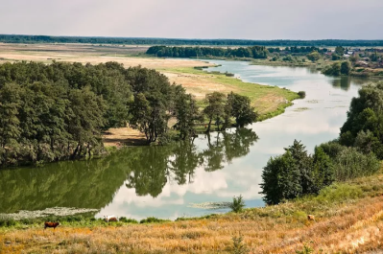
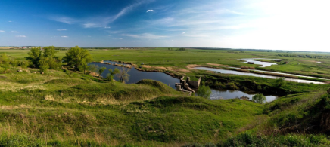
The Hopper as it is
The Hopper is a large river
in Penza, Saratov, Voronezh
and Volgograd Regions of Russia.
It is the largest left stream of the Don.
Its length is 980 km,
the square of the
river basin is 61 100 km².
The width of the river
is about 100 m and
the depth is 17m. The river is supplied
mainly with snow. The flood time
is in April and May. It is totally covered
with ice in December. The bottom of
the river is sandy. The current
is quickly. There are a lot of lakes
in the valley where the river flows.

Slide 4
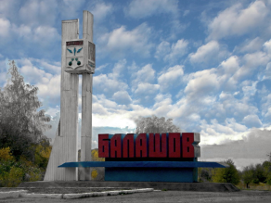
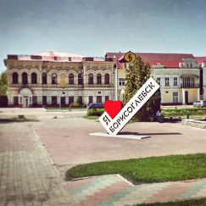
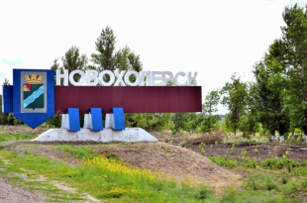
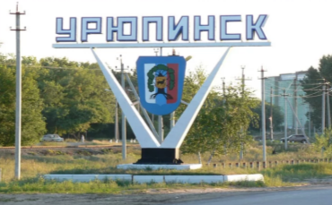
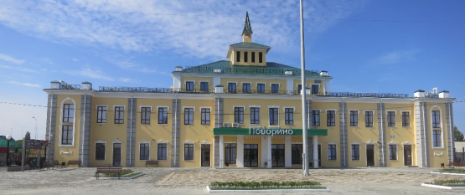
The towns
There are such towns as
Balashov, Arkadak,
Uryupinsk, Borisoglebsk, Povorino,
Novohopersk
on the river.

Slide 5
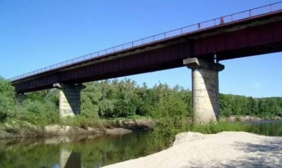
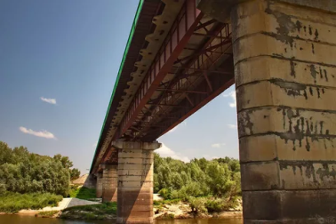
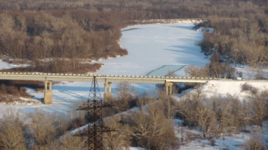
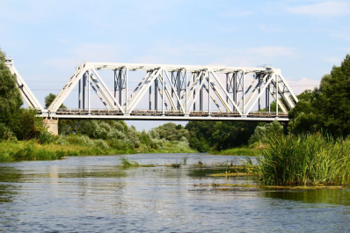
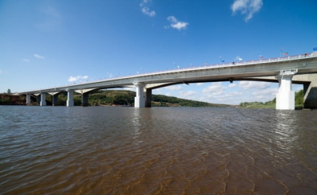
The bridges
There are a lot of bridges on the Hopper. The height of some of them is about 18-26 m.

Slide 6
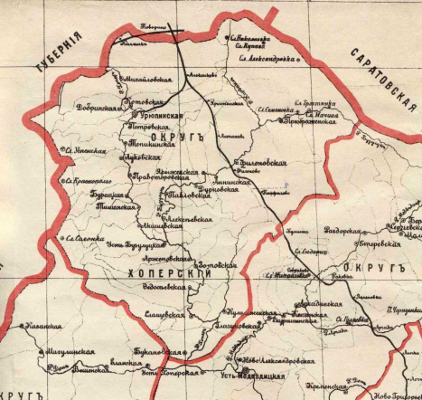
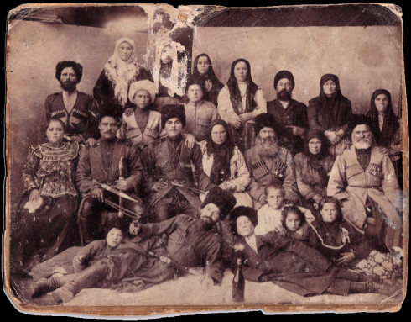
Some historic facts
The valley where the Hopper flows was one of the places where the Don Cossacks settled.

Slide 7
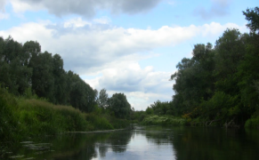
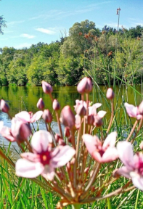
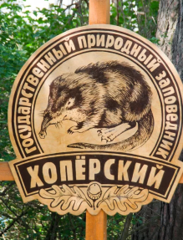
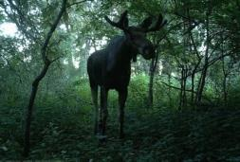
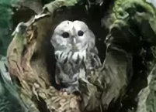
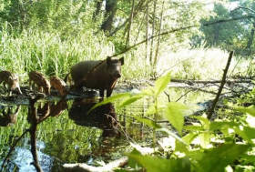
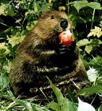
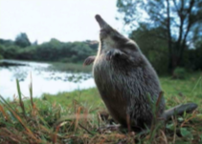
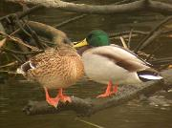
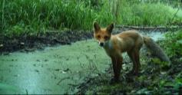
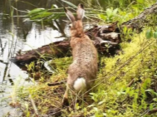
National parks: nature and animals
In the valley of the river there are some reserves and national parks which were organised in the middle of 20th century. They are Almazov, Hopper and Arkadak reserves and Hopper National Park. The nature, plants and animals are very beautiful, rich and unique there. You can see elks, hares, egrets, swans, eagles, falcons, owls, nightingales, ducks, beavers, river turtles, snakes and other animals there.
Such animals as foxes, European hares, beavers, desmans, wild boars are protected.

Slide 8
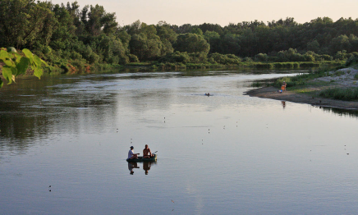
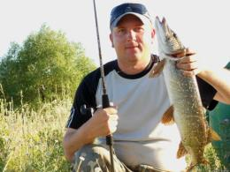
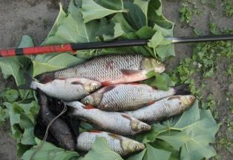
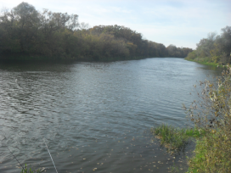
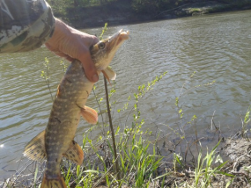
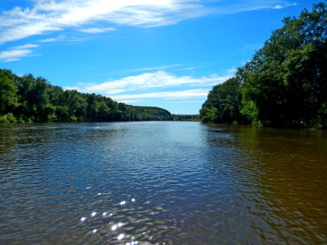
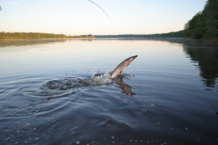
Fish and fishing
There is a lot of different kind of fish in the river and the Hopper became the favourite place of fishing.

Slide 9
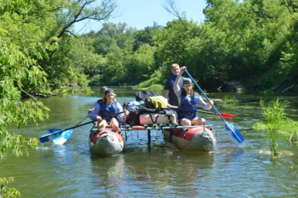
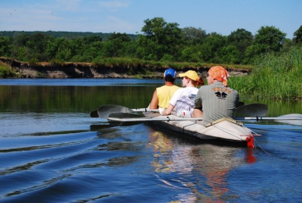
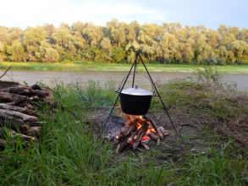
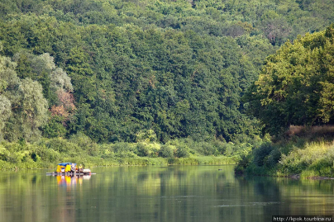
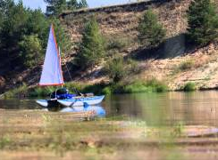
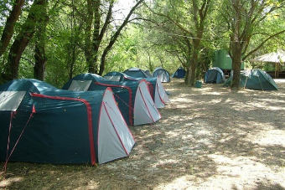
Tourists on the Hopper
The unique nature makes the Hopper the popular tourist place.

Slide 10
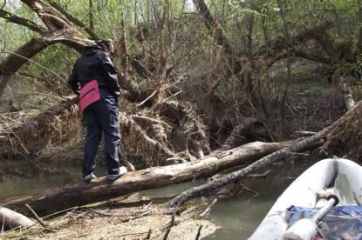
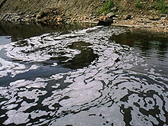
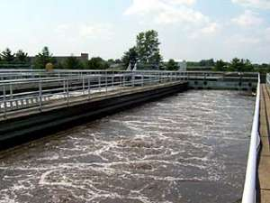
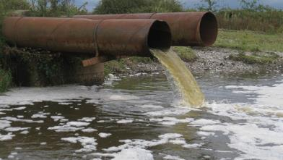
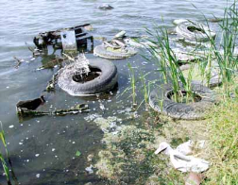
Ecological situation
Nowadays the ecological situation of the Hopper River is not favourable. There are tree piles, especially near Balashov, which destroy the river bed. The pollution of oil is fixed in recent years. The pollution of ammonia is denoted in Arkadak and Balashov Districts.

Slide 11
Internet-resources
http://wikirtishchevo.shoutwiki.com/wiki/Хопёр
https://megaribolov.ru/index.php/entsiklopediya-rybolova/opisanie-vodoemov/opisanie-rek/1704-reka-kho
https://ru.wikipedia.org/wiki/
https://yandex.ru/images

