Slide 1
INTRODUCTION
Сюжетная линия к уроку «Видовременные формы английского глагола (коммуникативный аспект)»

Slide 2
I’m Clair Taylor.
I live in Oxford
but work in London.
I’m the director of
an employment agency
called ‘Work International’.
They help people to find
work abroad.

Slide 3
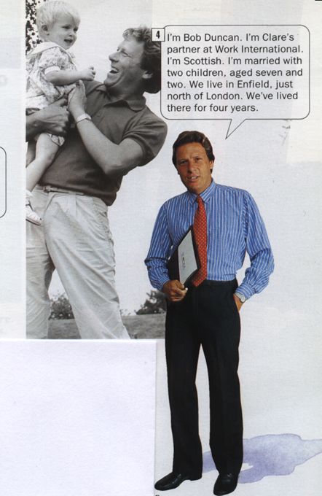
I’m Bob Duncan.
I’m Clair’s
partner at
Work International.
I’m Scottish. I’m
married with two
children, aged
seven and two.
We live in Enfield,
just north of London.
We’ve lived there for
four years.

Slide 4
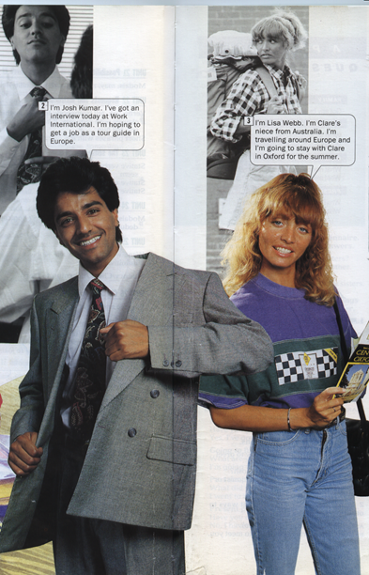
I’m Josh Kumar. I’ve got an interview at Work International. I’m hopping to get a job as a tour guide in Europe. | I’m Lisa Webb. I’m Clair’s niece from Australia. I’m travelling around Europe and I’m going to stay with Clair in Oxford for the summer.

